Slide 1
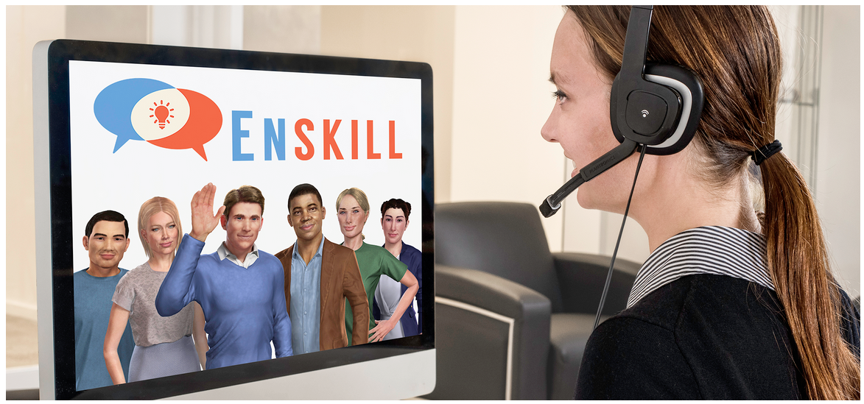
Using Alelo Simulations to Build Fluency and Self-Confidence
Lewis Johnson, PhD and Karen Chiang

Slide 2
Key advantages
    Build student confidence
    Practice communication, not just speaking
    Provide individualized practice
    Provide personalized feedback
    Support large classes
    Utilize class time more efficiently

Slide 3
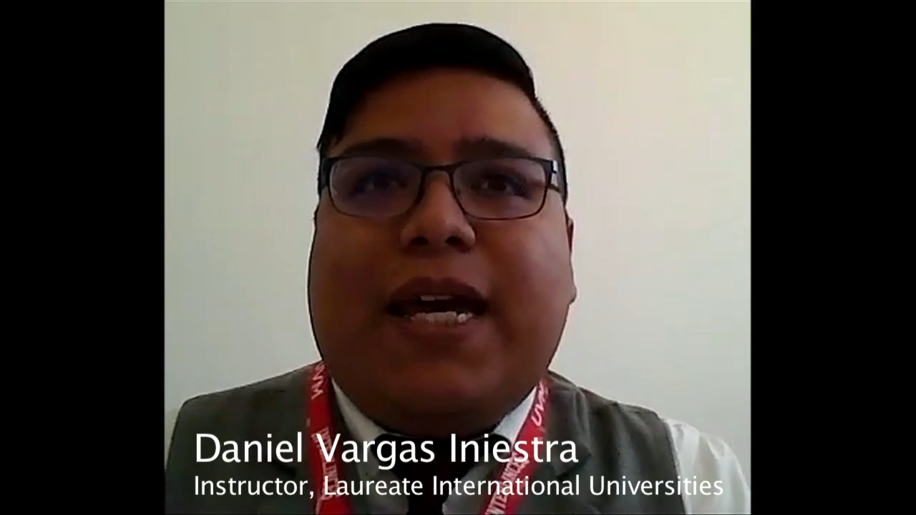
Case Study at UVM Campus Toluca
Students using Alelo Enskill at UVM, a Laureate institution in Mexico, developed greater proficiency and self-confidence in English communication.
“It helps me to improve my classes and also it makes my classes very very short and very very communicative.”
“If you want your students to have more self-confidence, Alelo is going to be your best option.”
“When I was a kid I wish I had this kind of platform because it helps in confidence.”

Slide 4
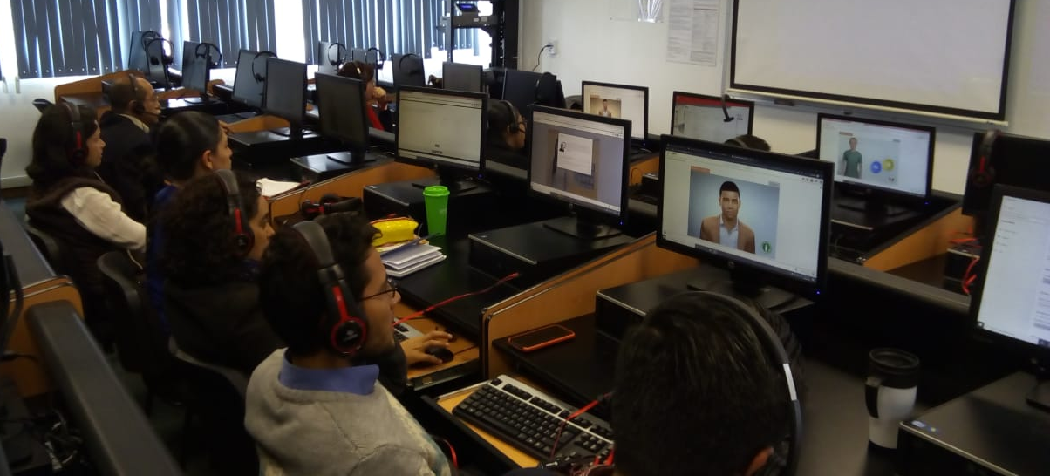
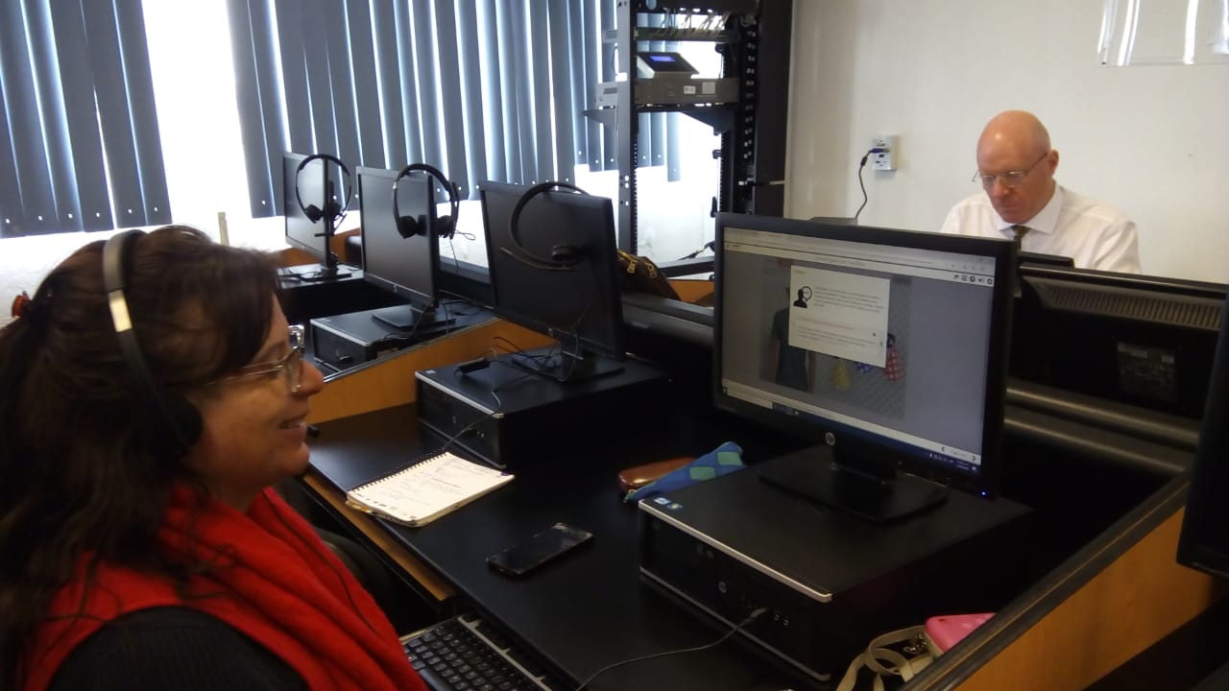
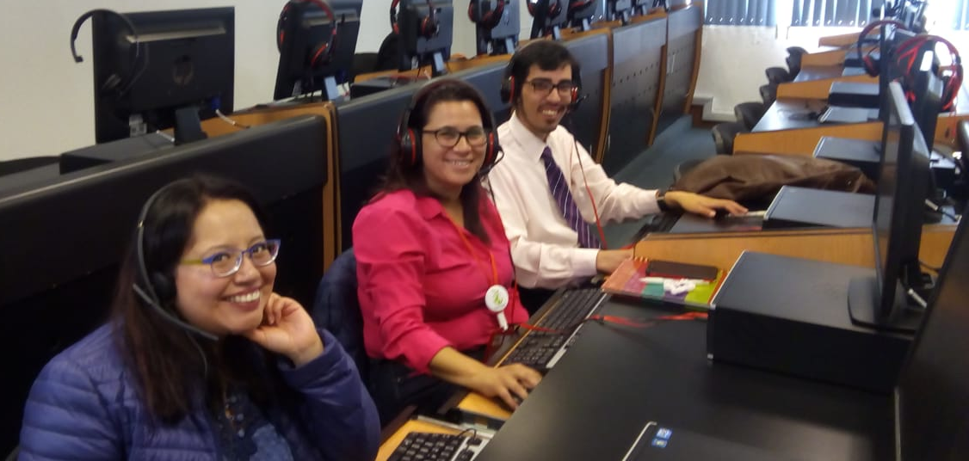
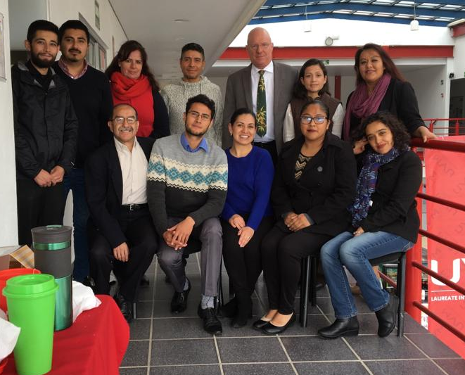
UVM Campus Toluca training session

Slide 5
How students can use simulations
Students can:
  practice and try new language
    in simulated real world scenarios
    anytime, anywhere
    at a pace comfortable to the student
    as many times as desired or needed
    but without fear
    with the added plus of real time feedback

Slide 6


Introductory Videos

Slide 7
Platform Introduction

Slide 8
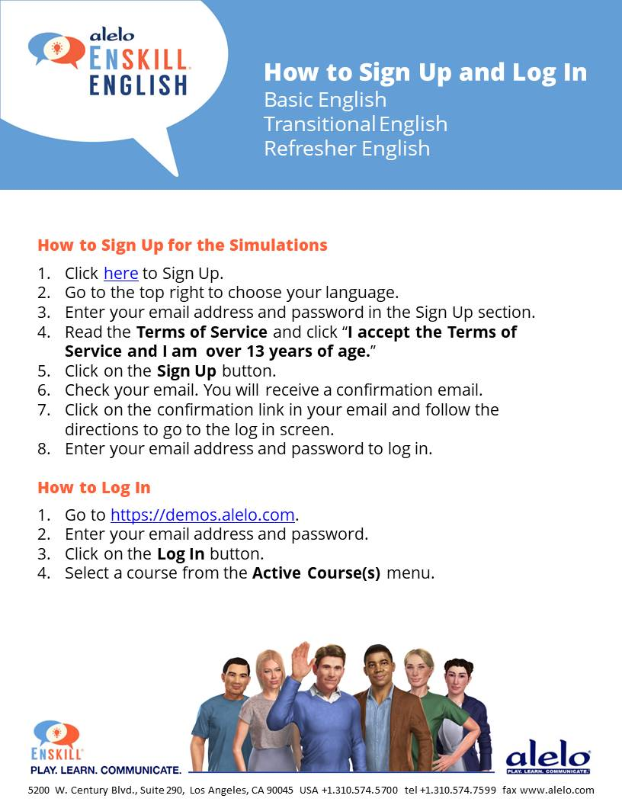

Slide 9
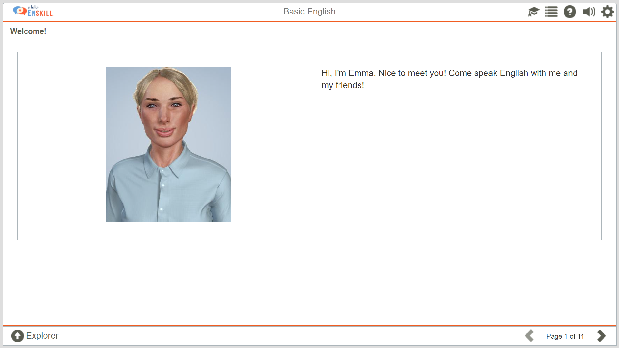
Welcome to the platform

Slide 10
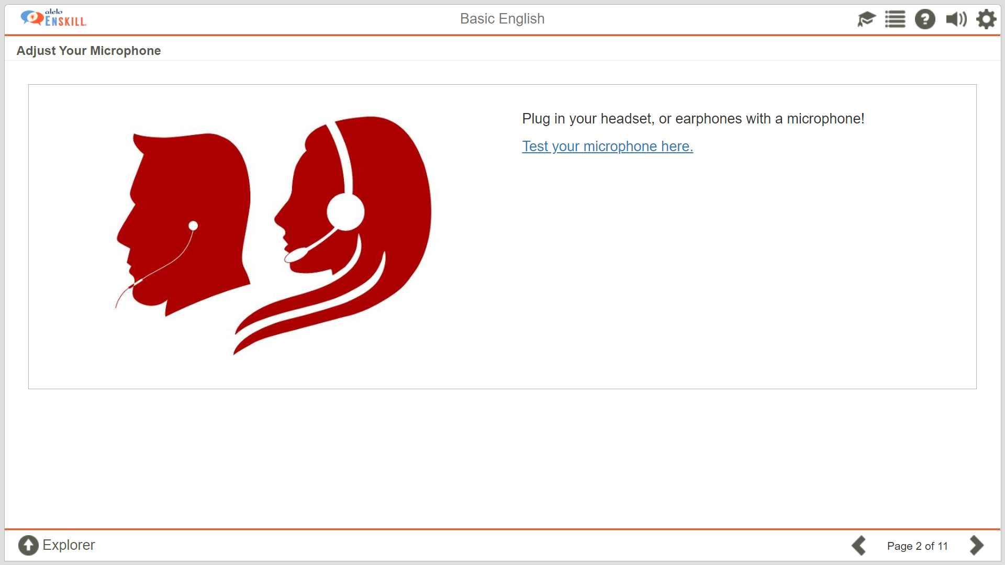
Reminder to check headset and microphone

Slide 11
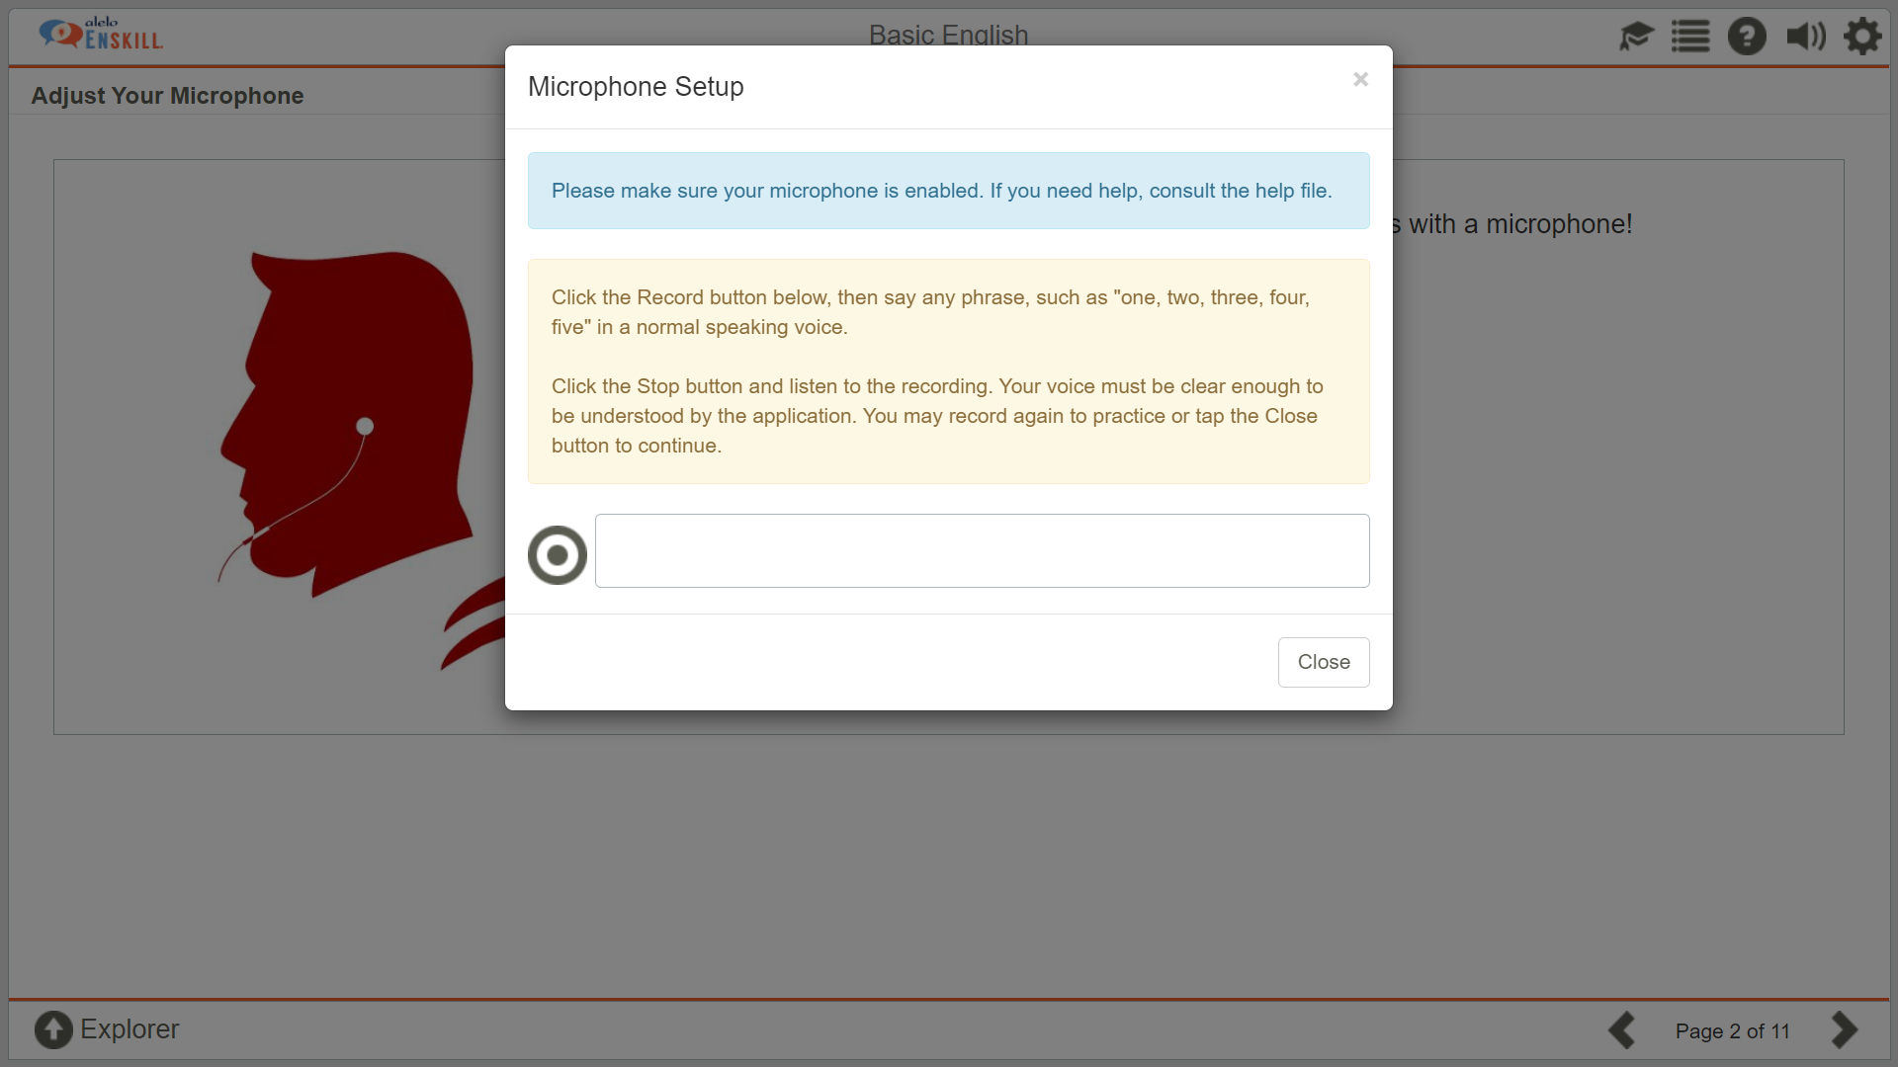
Record Button
Try recording. Click to start, click to stop

Slide 12
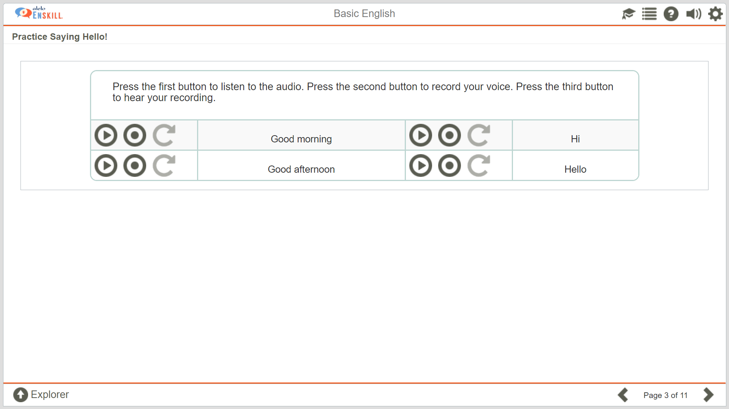
Learners are asked to try simple greeting to ensure headset and microphone are working and that learners understand how to use the record buttons

Slide 13
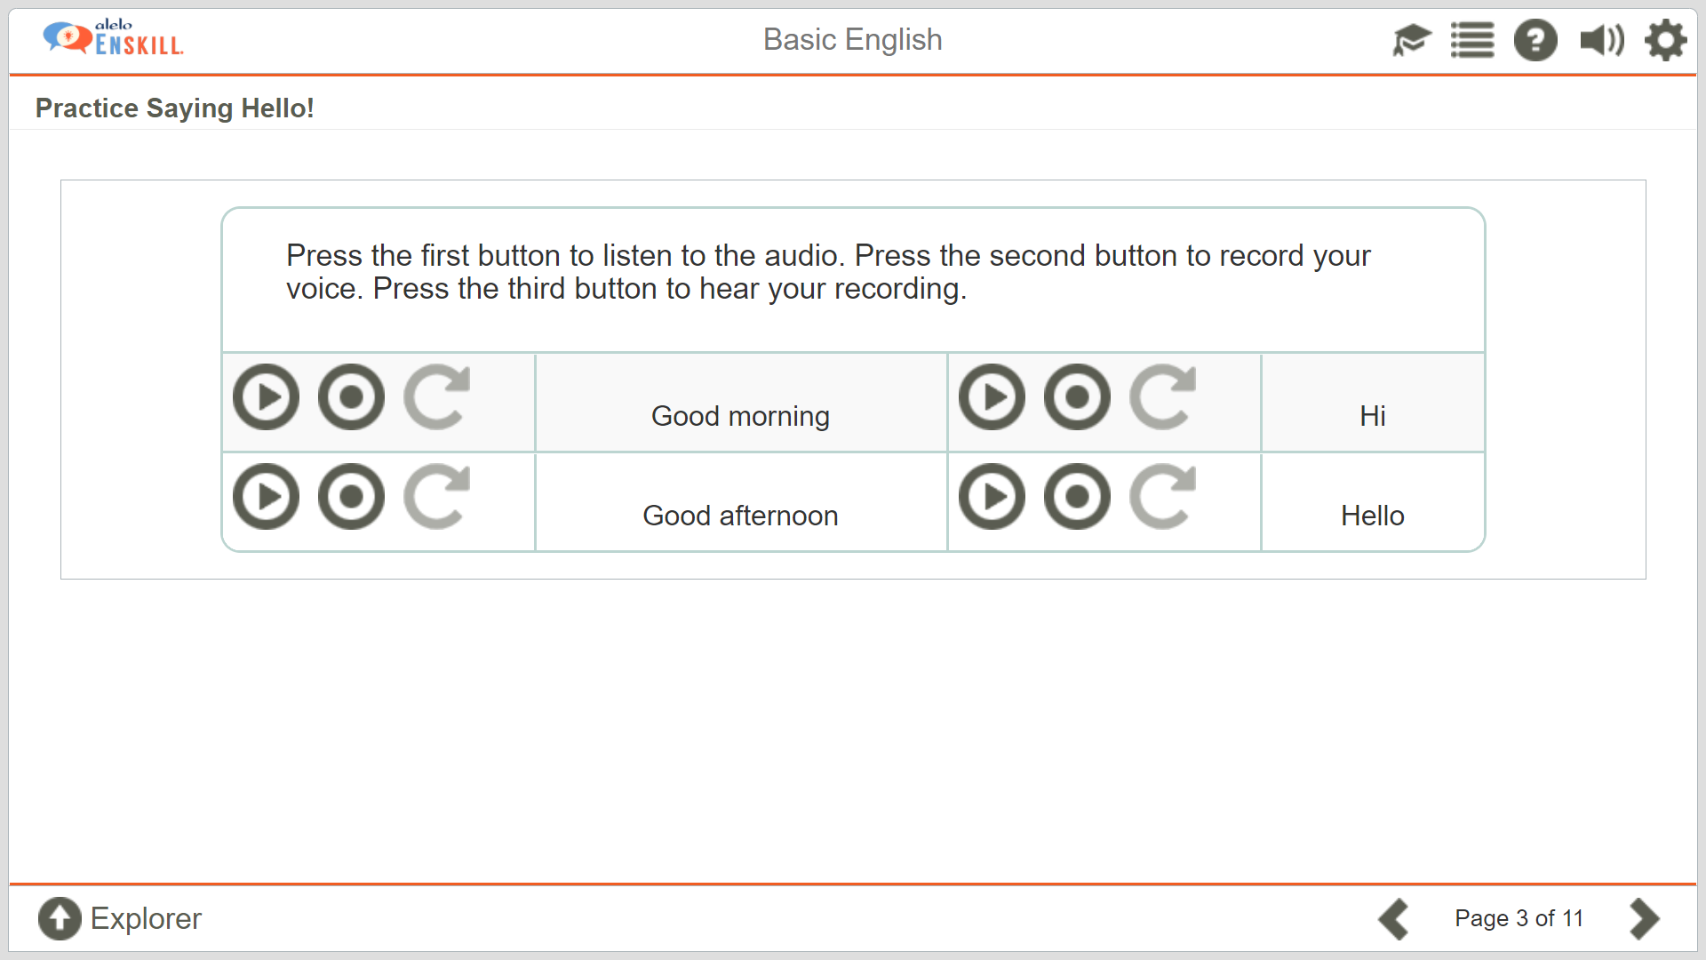
1. Click to listen to an example
2. Click to record
3. Click to playback recording

Slide 14
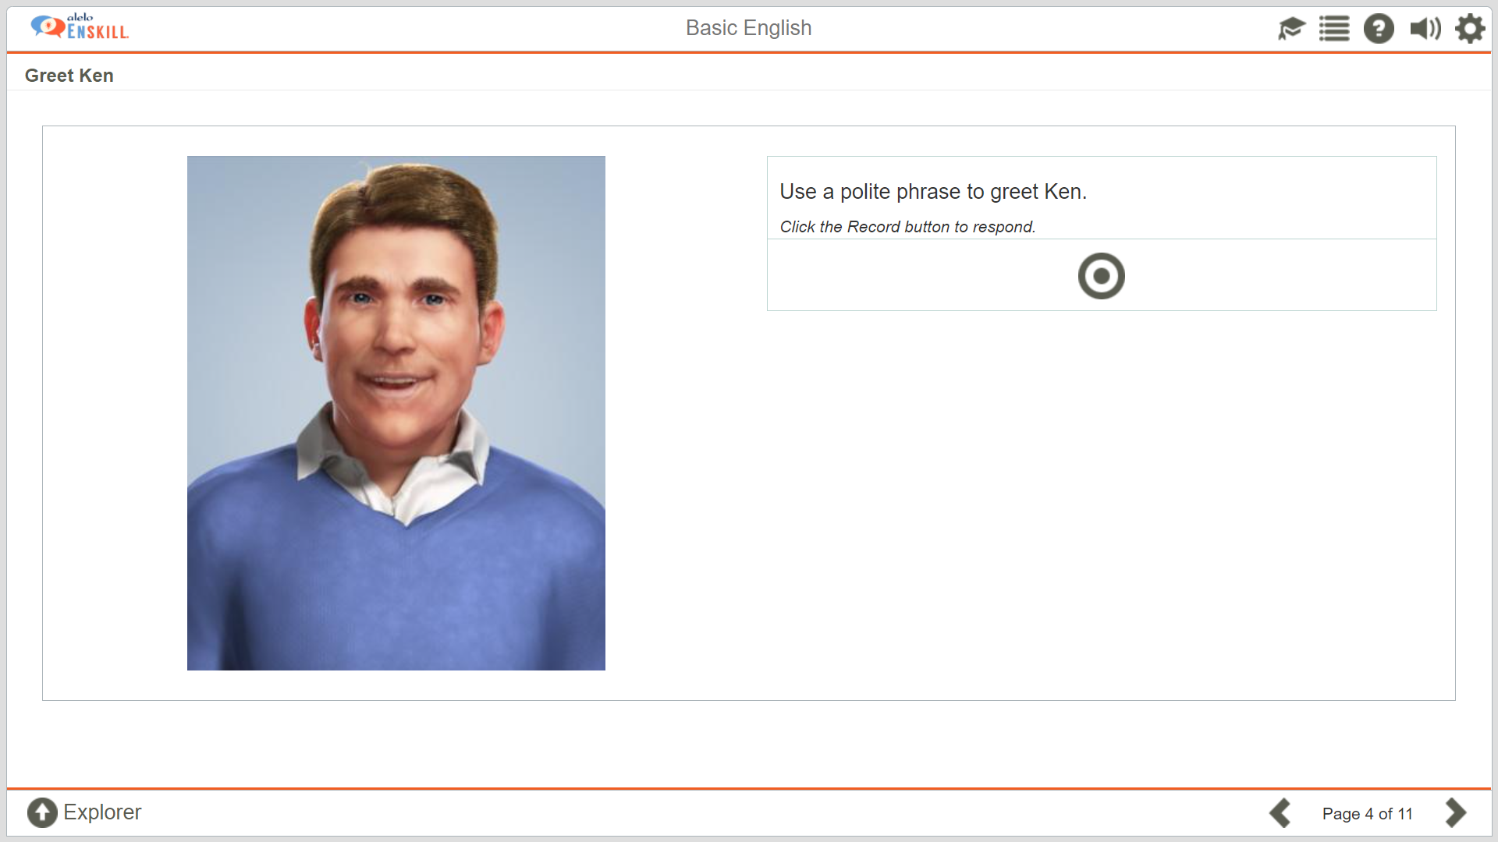
Learners try greeting the avatar/character

Slide 15
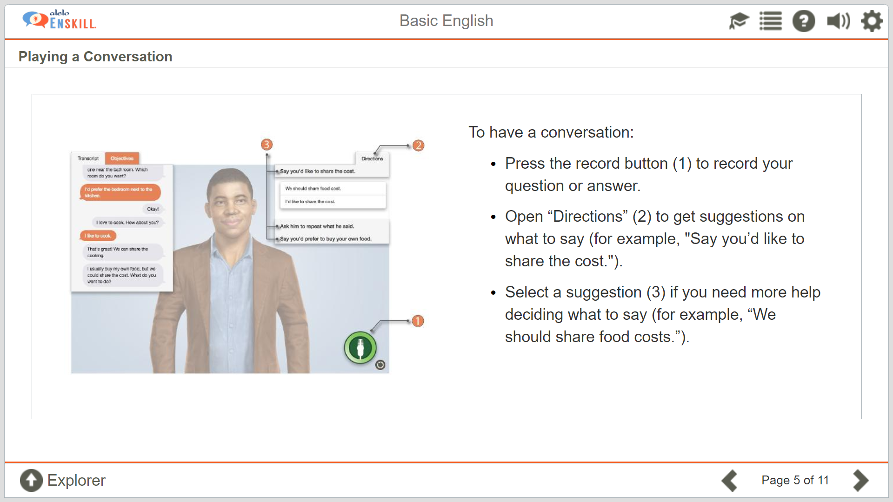

Slide 16
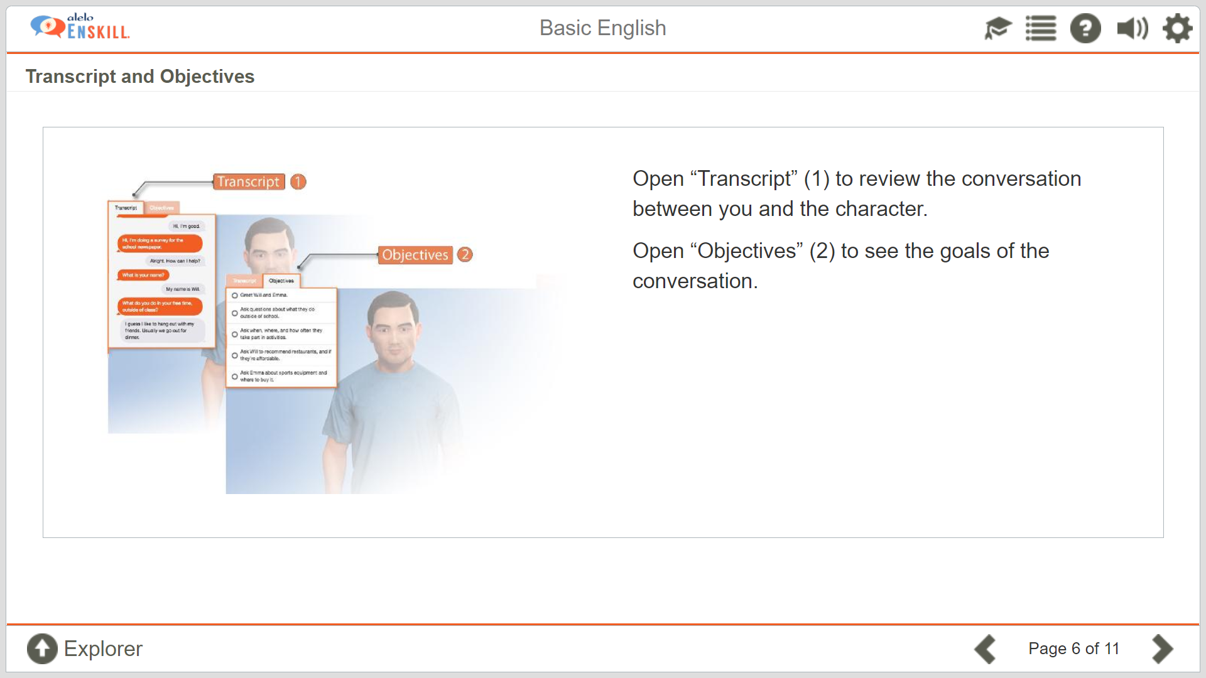
Click Objectives to see what the objectives are of the simulation
Click Transcript to see what the avatar and learner has said

Slide 17
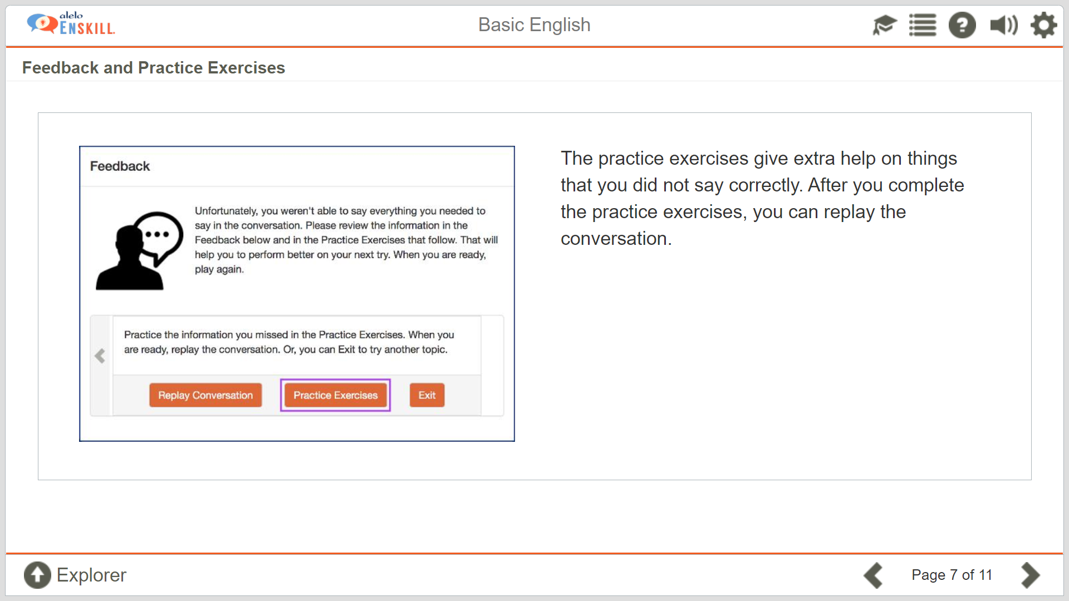
When learners complete the simulation they receive feedback if they have met the objectives
Learners are provided practice exercises in the areas that require improvement

Slide 18
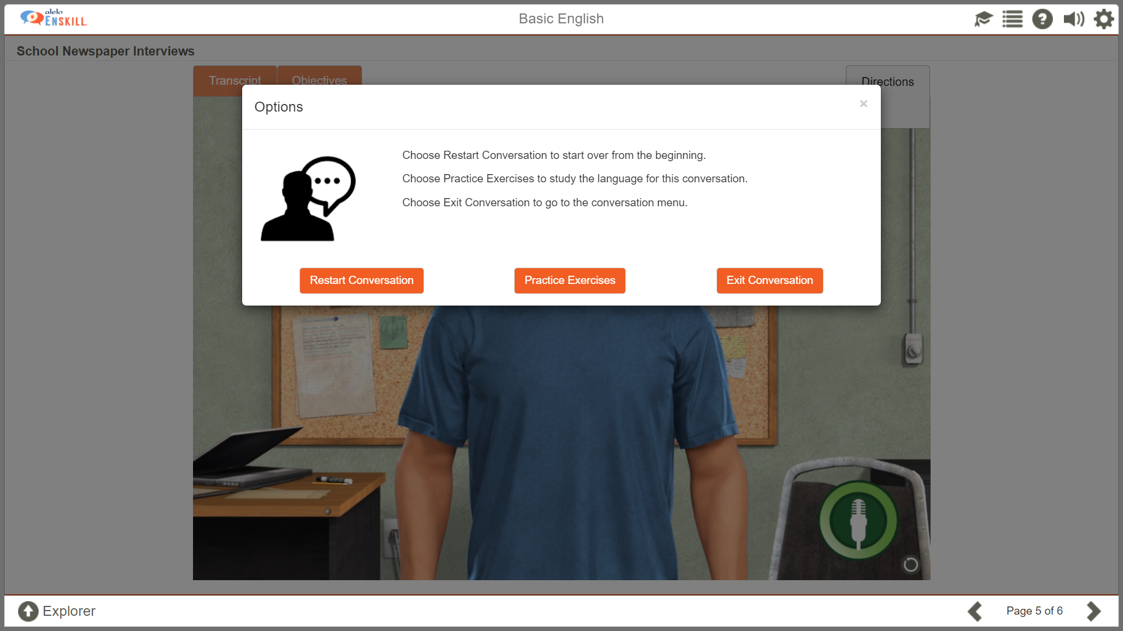
You can click on the Options button to at any time during a simulation.
At any time during a simulation, you can restart the conversation, go to the practice exercises, or exit the conversation.

Slide 19
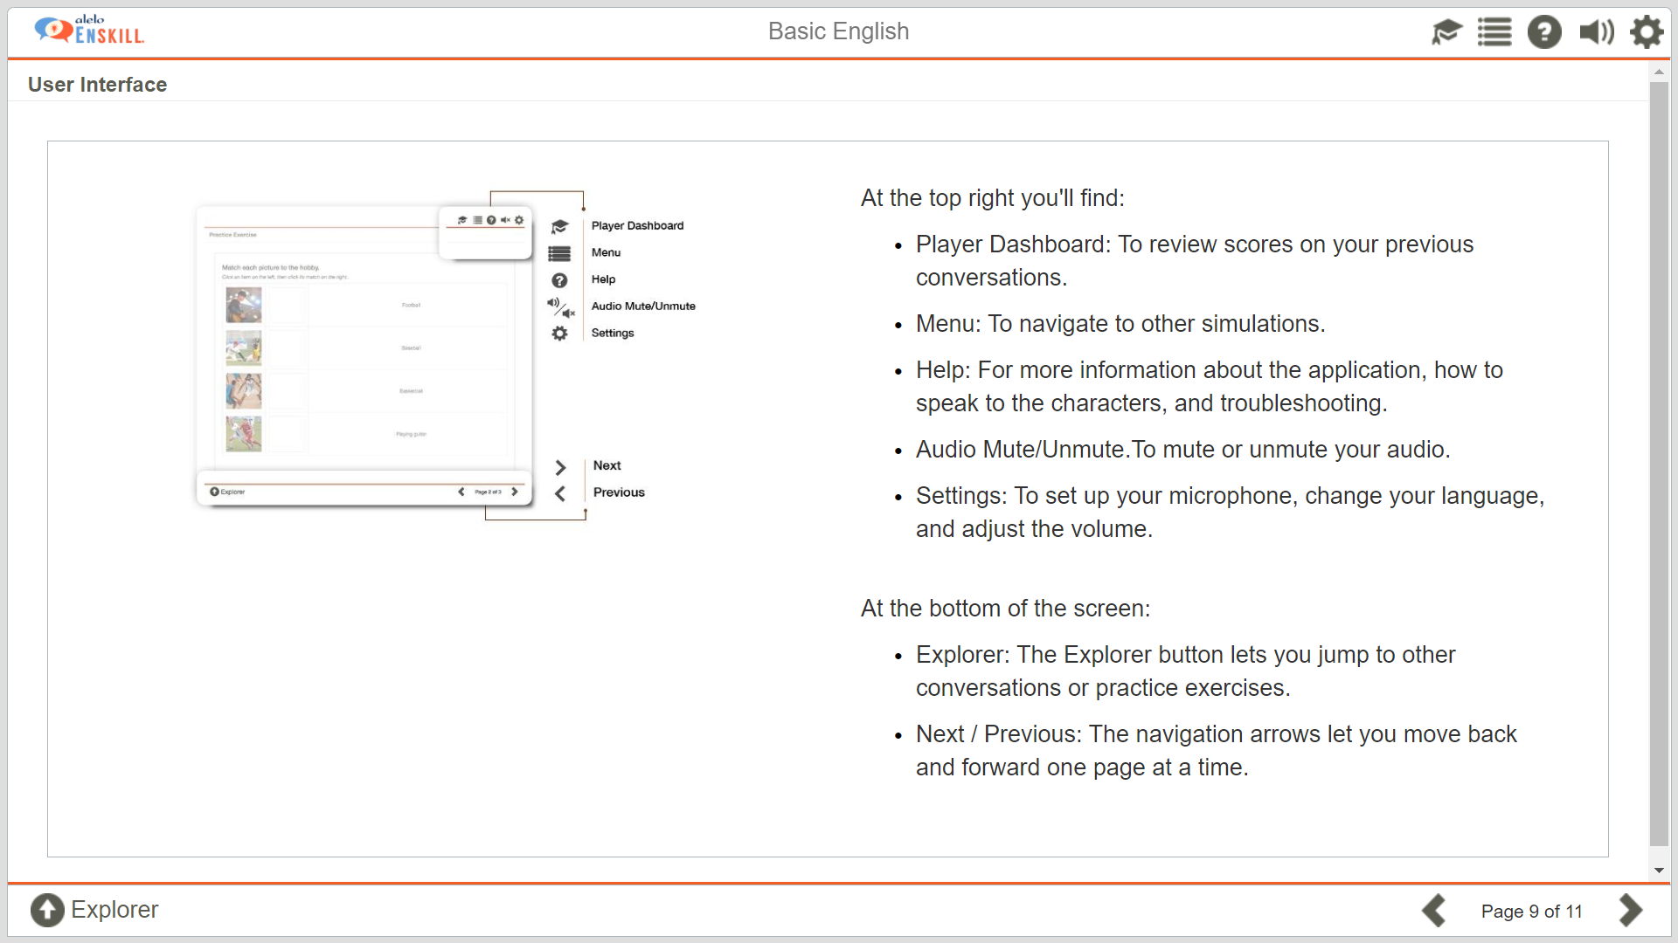
Other buttons help the learner to navigate in the platform

Slide 20
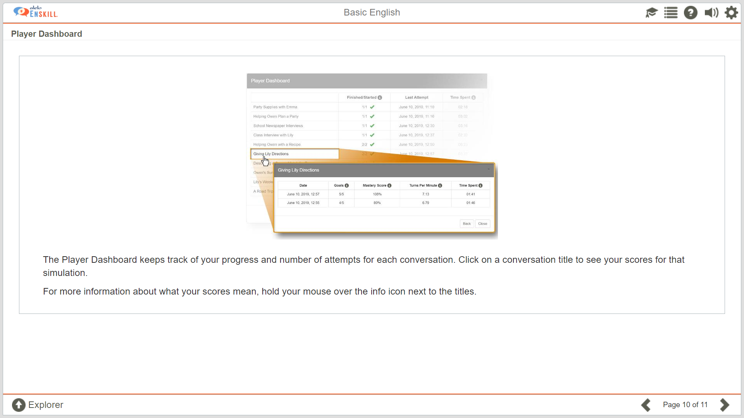

Slide 21
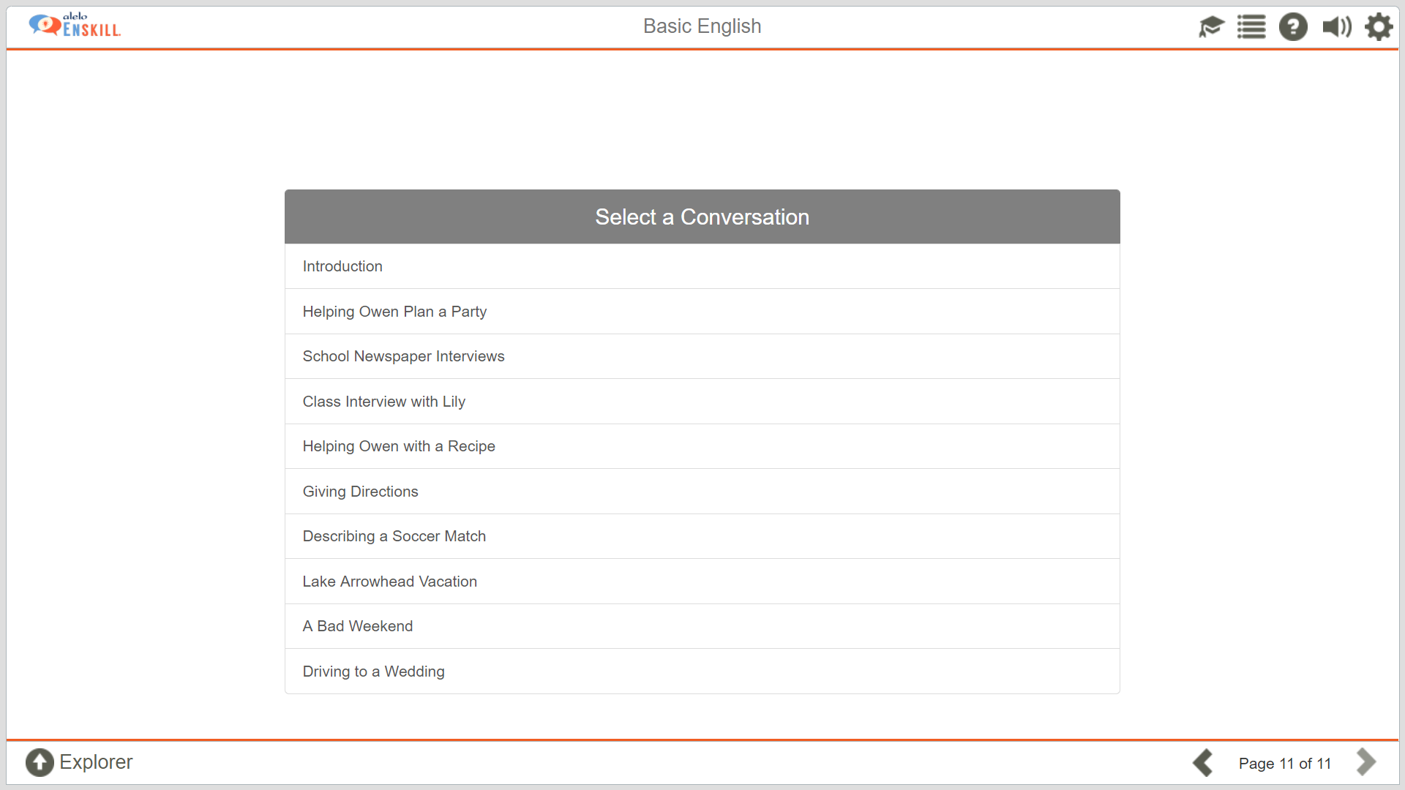
Learners are now ready to start practicing with the simulations!

Slide 22
Sample Simulation

Slide 23
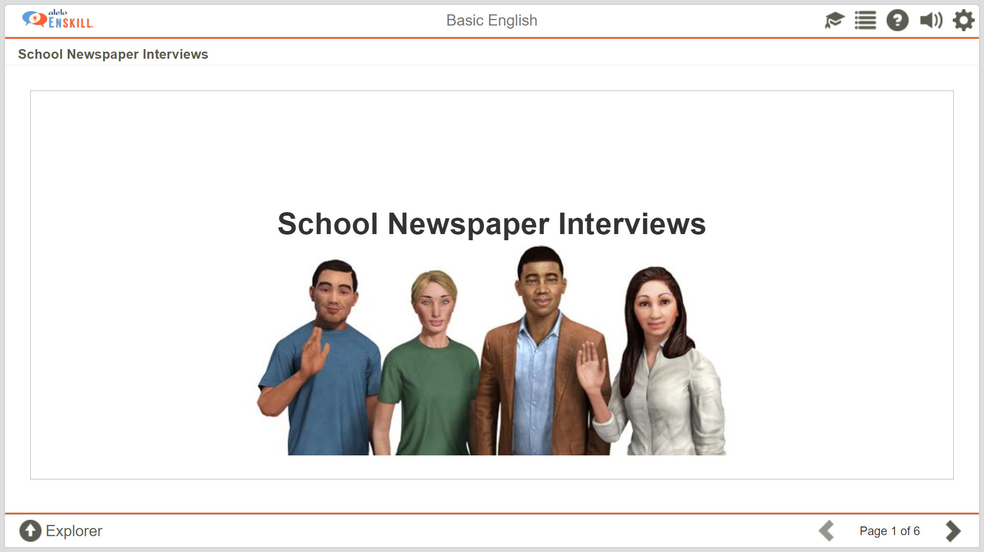

Slide 24
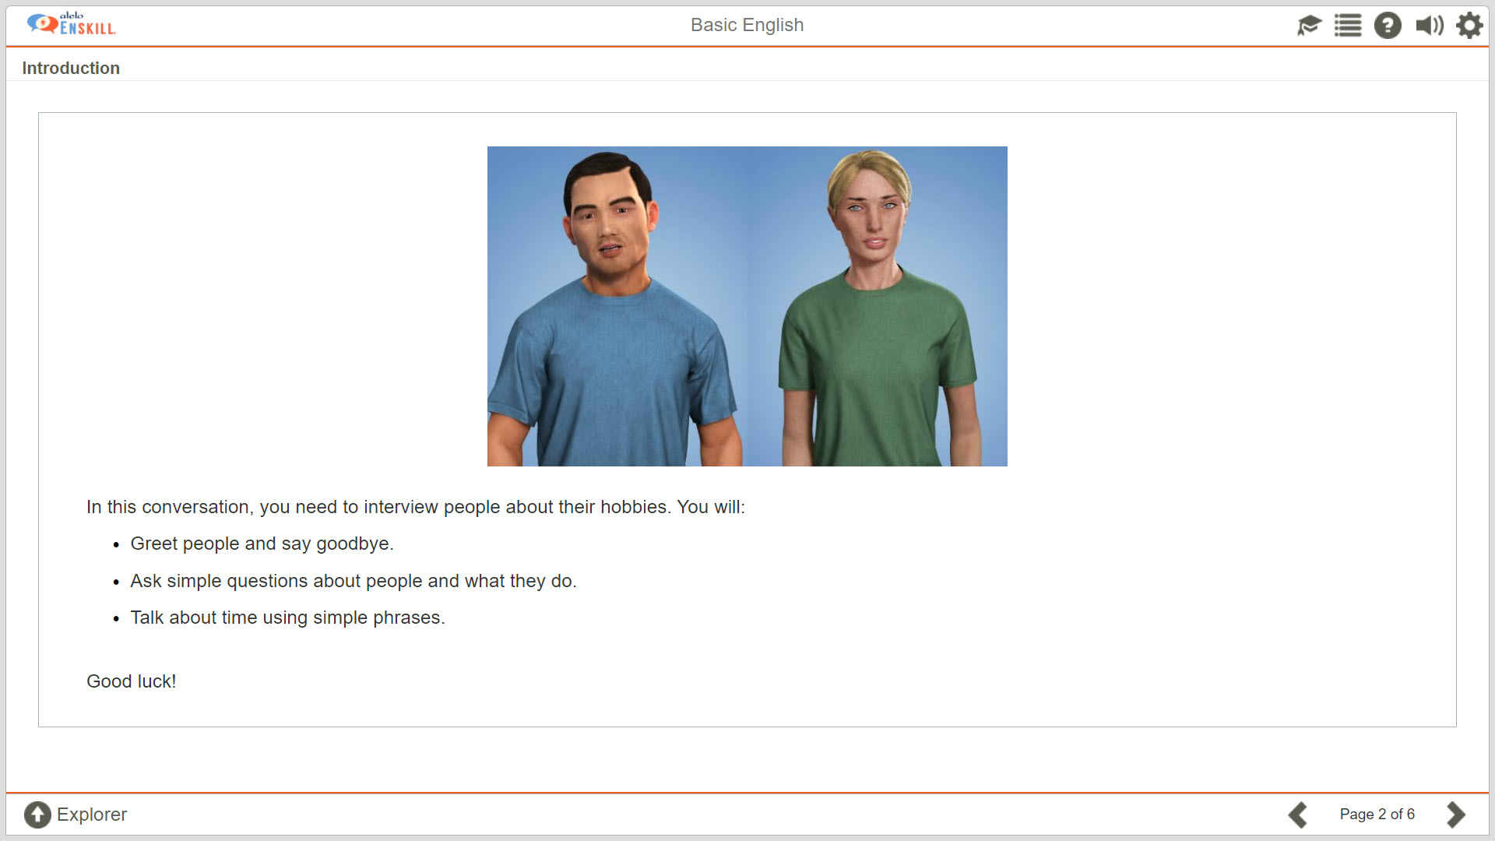
Introduction to the characters in the simulation

Slide 25
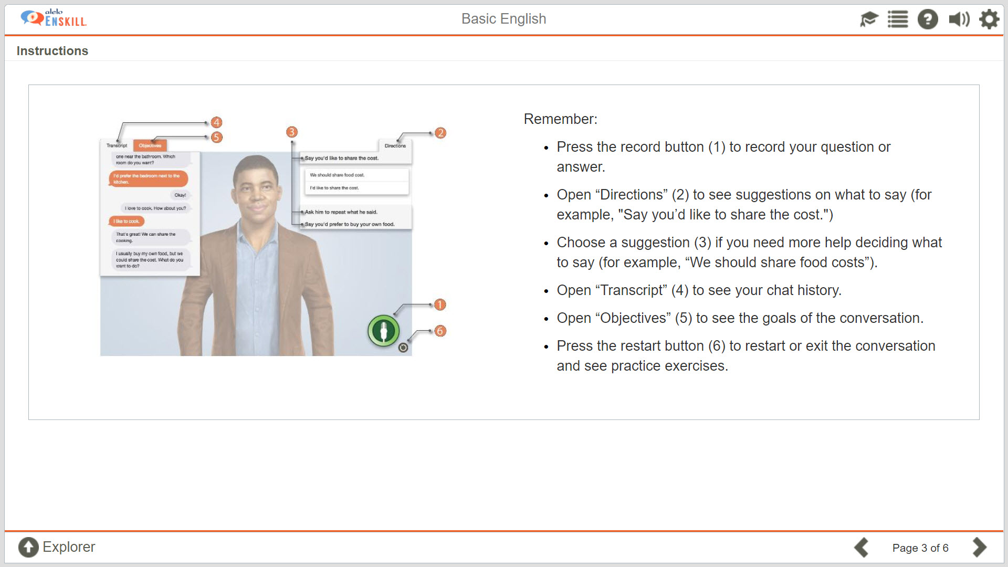

Slide 26
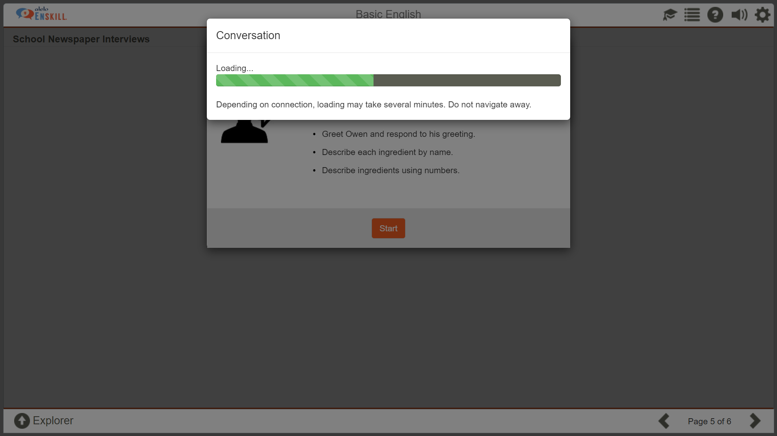
Simulation loading.
Loading time depends on bandwidth

Slide 27
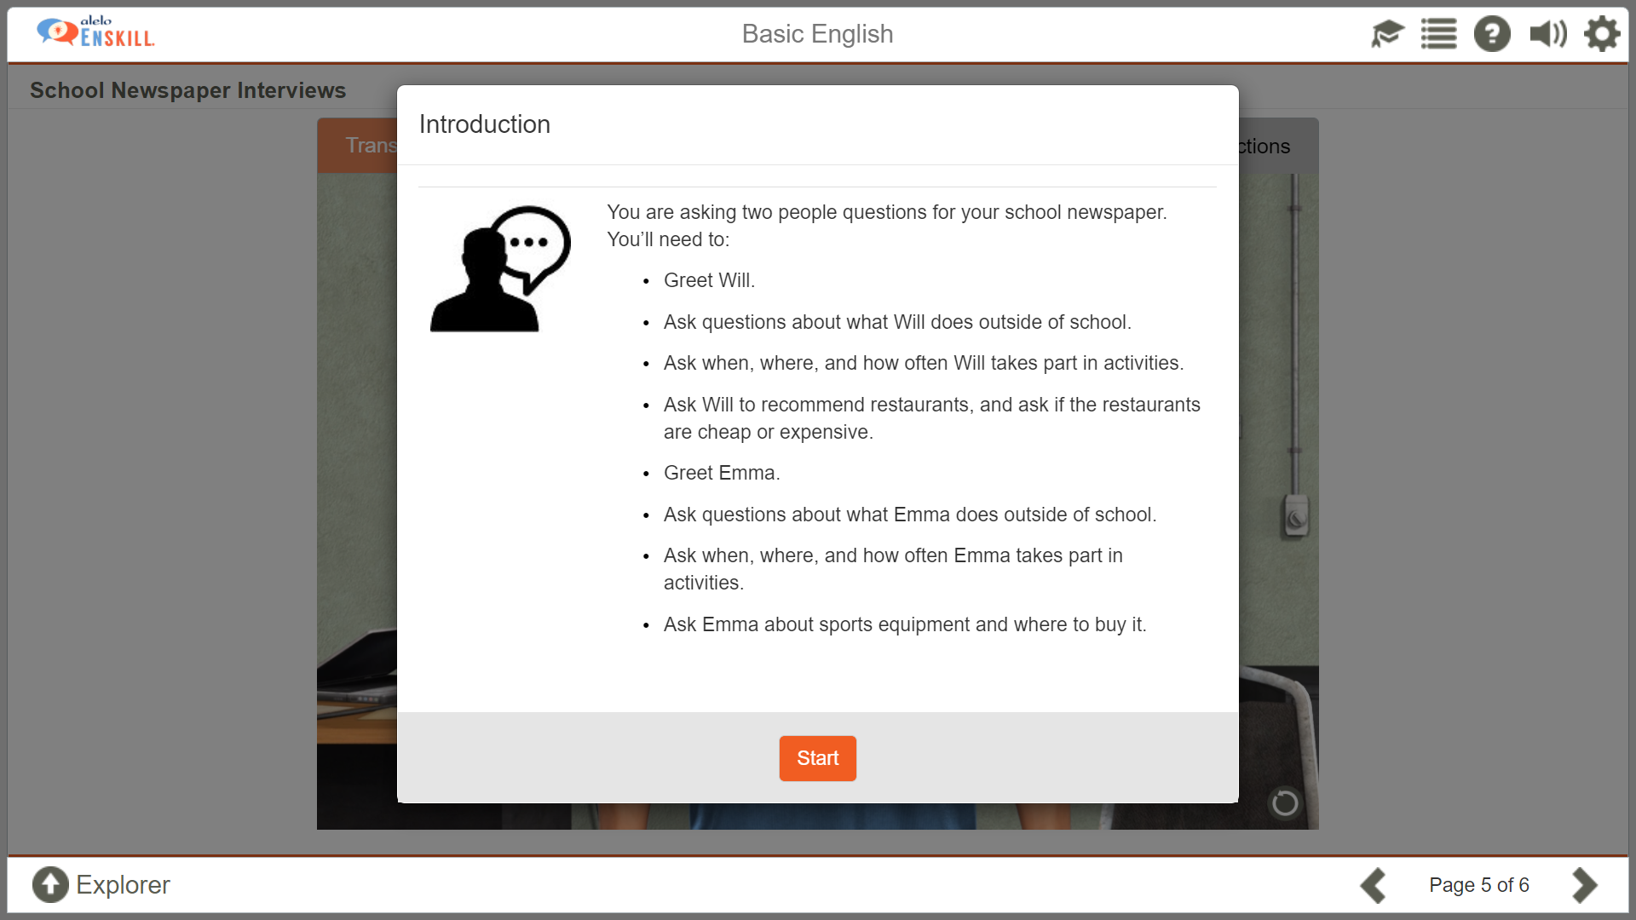
Simulation starts with an introduction to the objectives

Slide 28
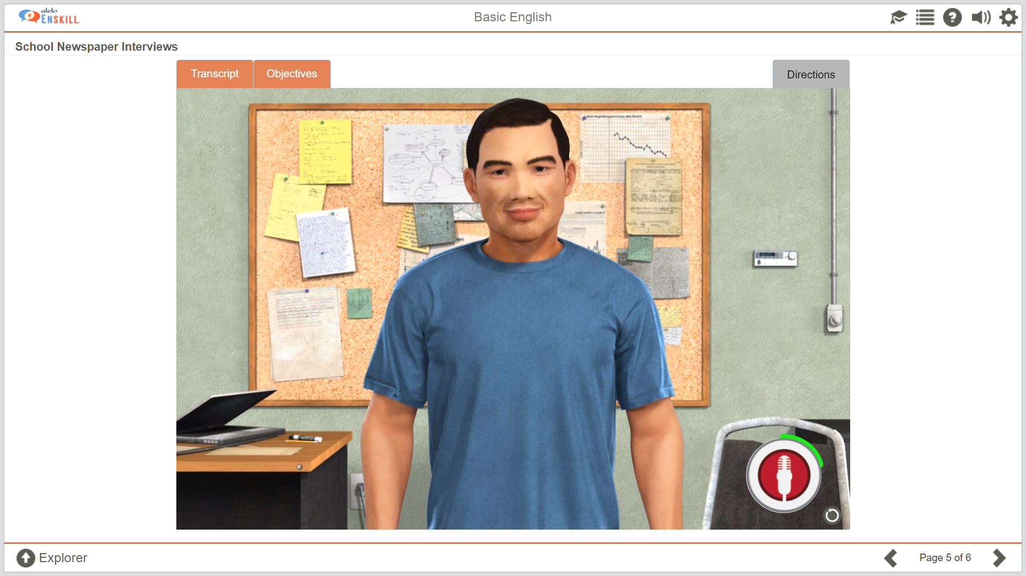
Character greets learner. Learner responds
GREEN around circle means that the system is recording the learner’s response

Slide 29
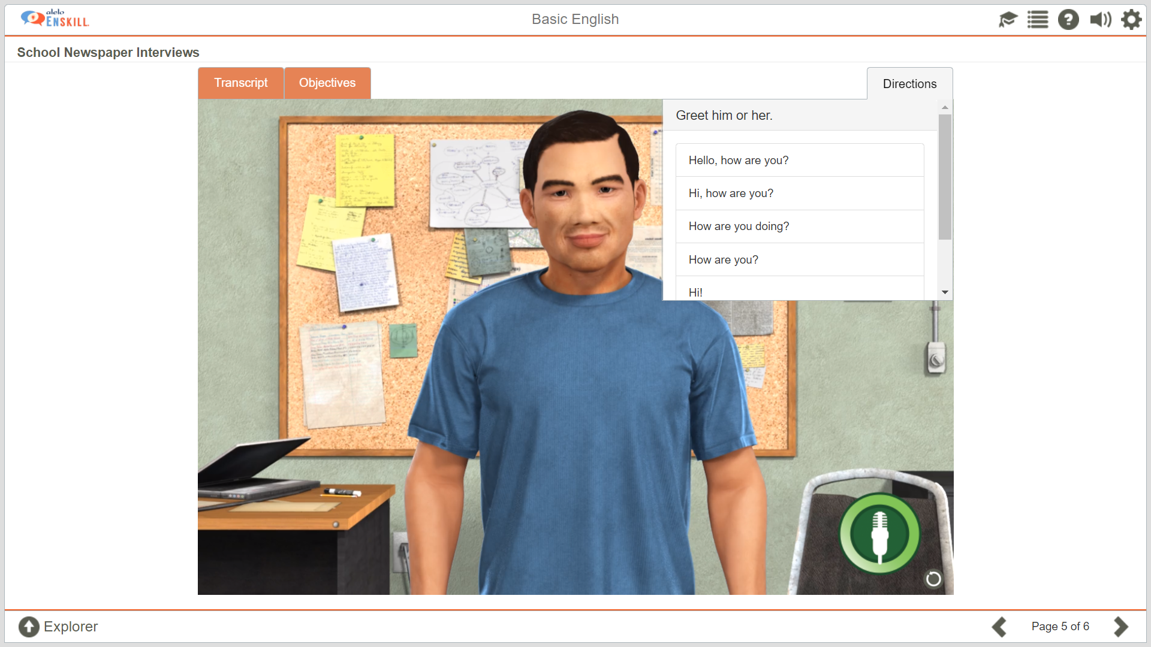
Guides learners to suggested questions or statements

Slide 30
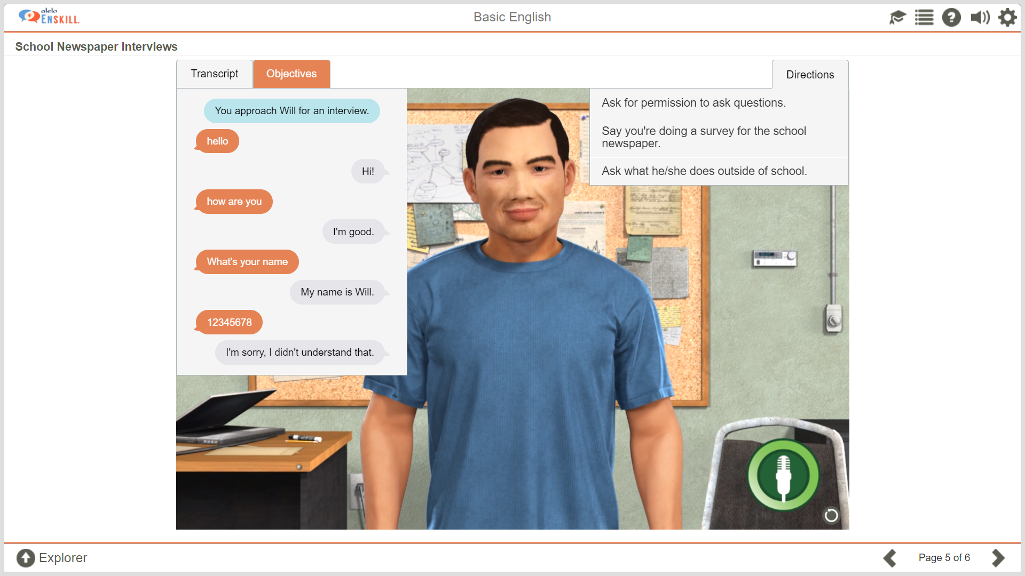
If the learner asks a question or makes a statement the system does not understand, the avatar responds with: “ I’m sorry, I didn’t understand that.”
Transcript of conversation between learner and avatar

Slide 31
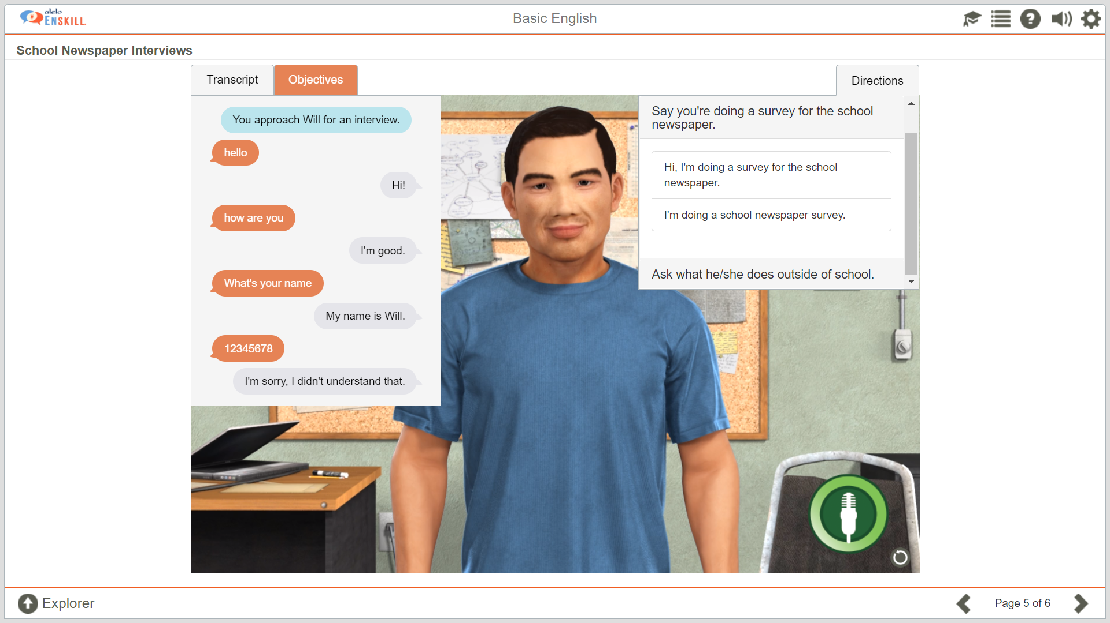
Suggestions of questions or statements.
Lower level learners can use these suggestions to complete the simulation

Slide 32
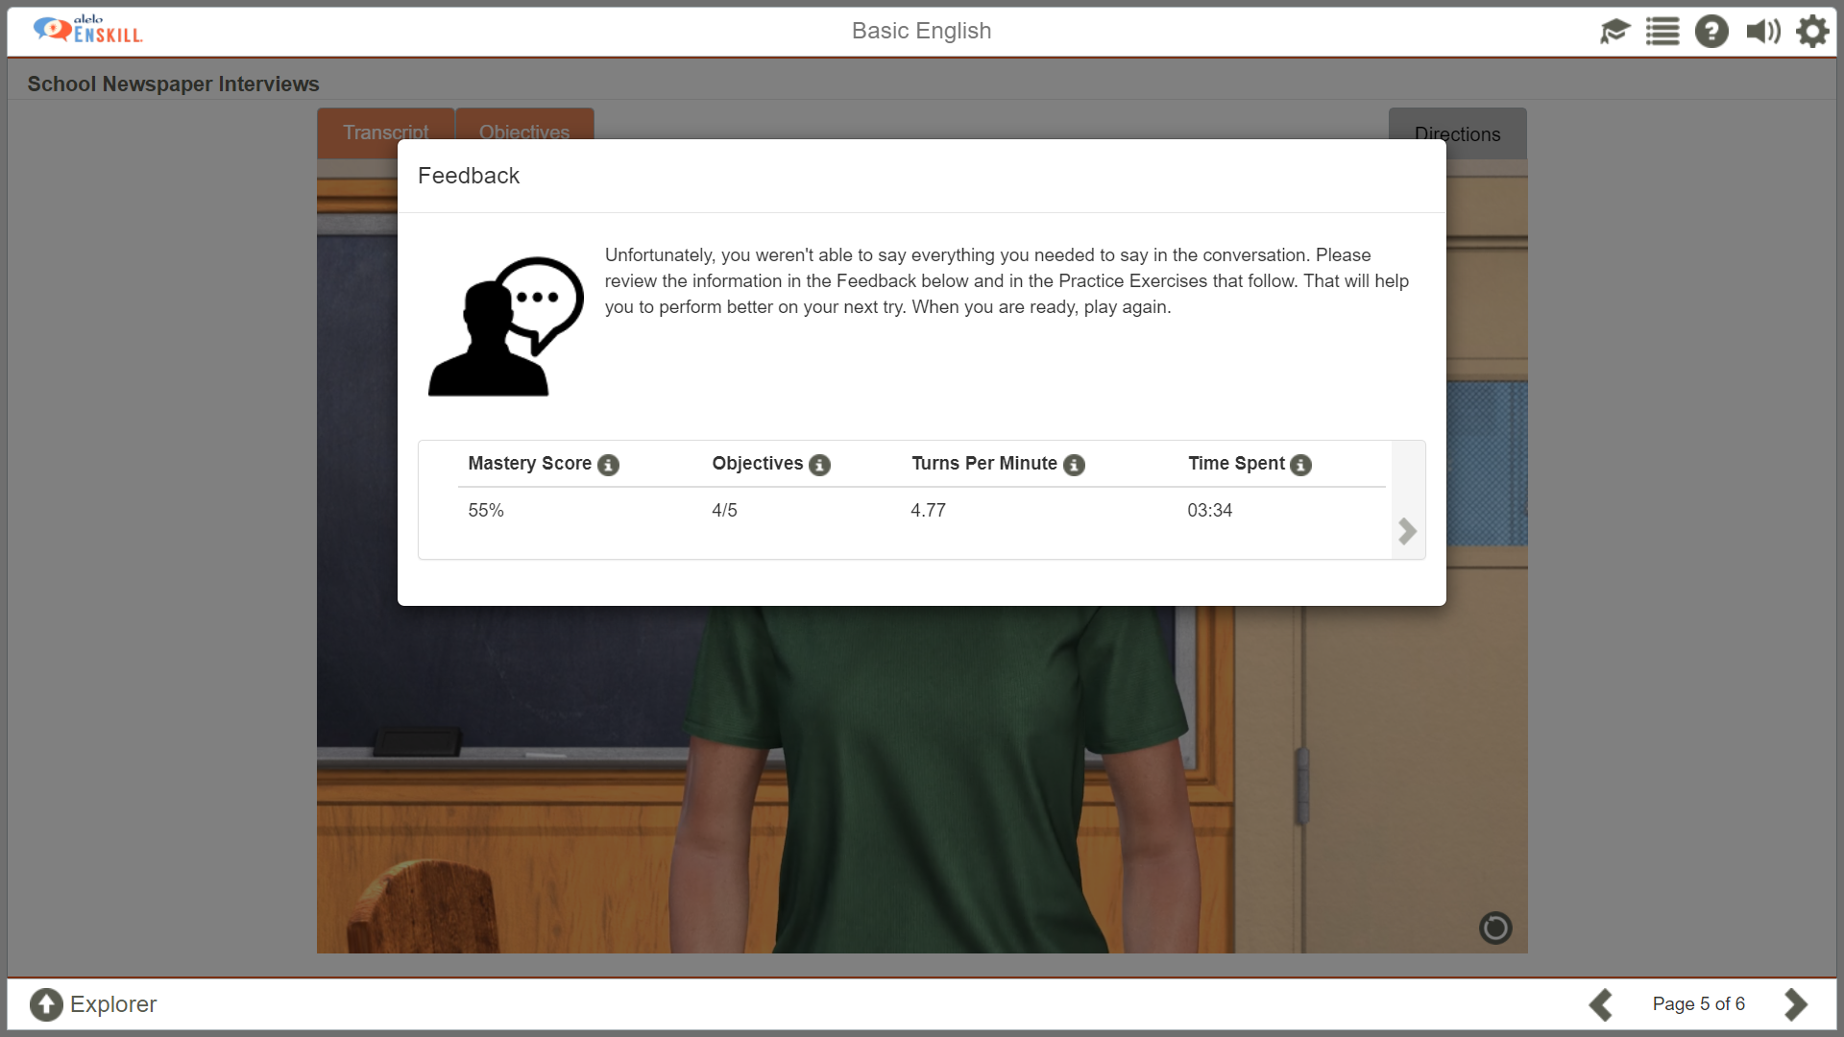
Learners receive feedback of performance after completing the simulation
Performance metrics

Slide 33
Performance metrics
Time spent
Objectives completed
Conversational turns per minute
  Other factors being equal, a higher score indicates greater fluency
Mastery score
  Based on objectives completed and turns per minute
  Normalized to 100% based on performance of all students at this level
Encourage students to keep practicing to improve their score

Slide 34
Performance dashboard

Slide 35
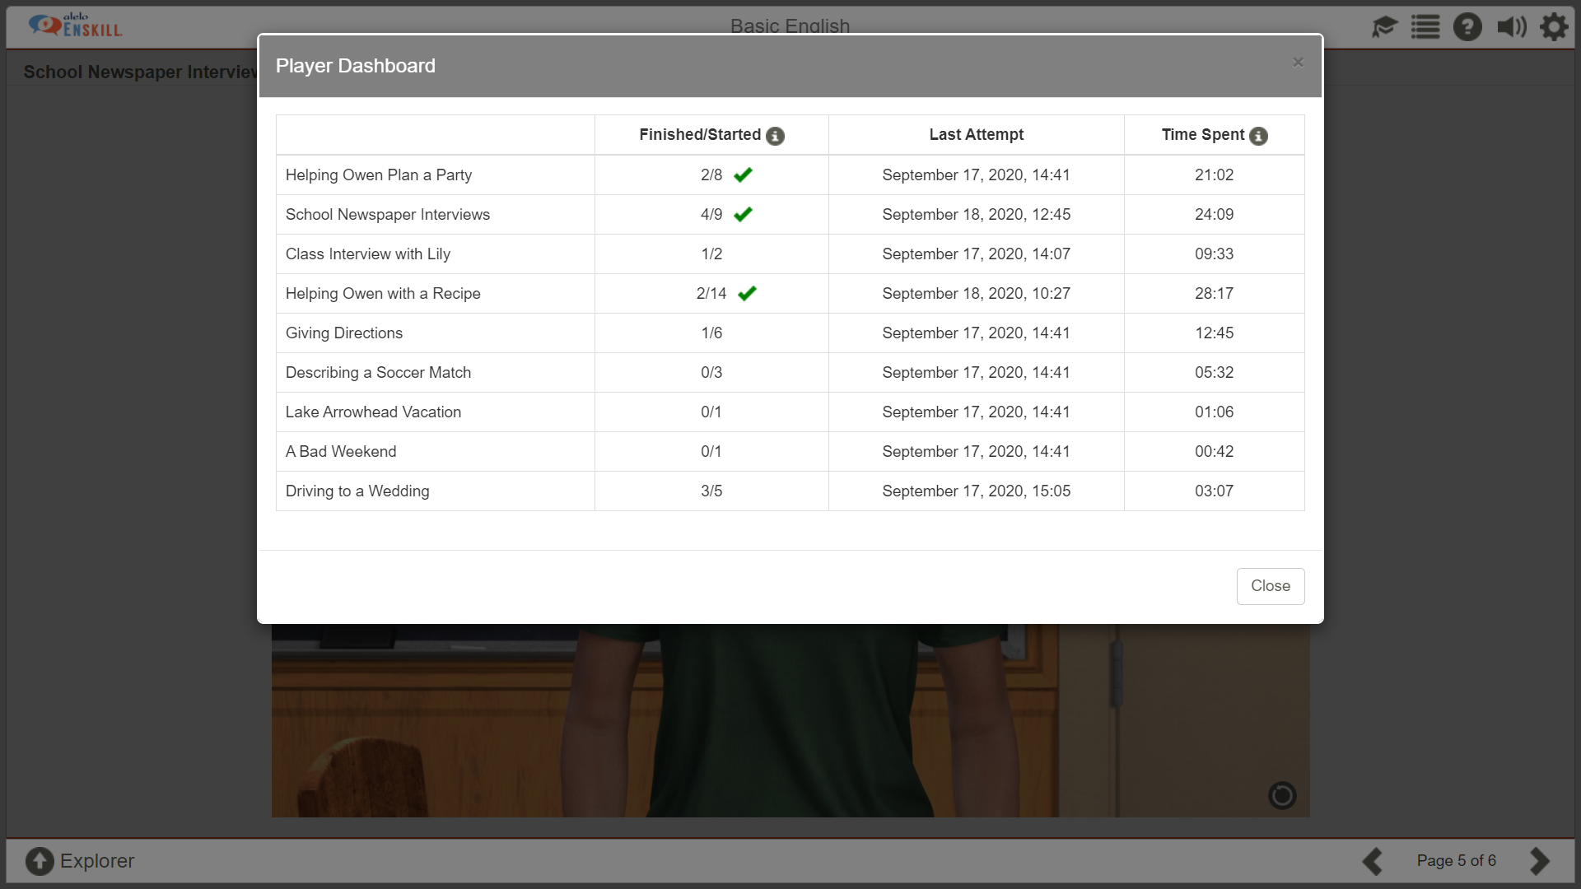
Number of times learner attempted and completed each simulation; ✓ means all objectives were met at least once

Slide 36
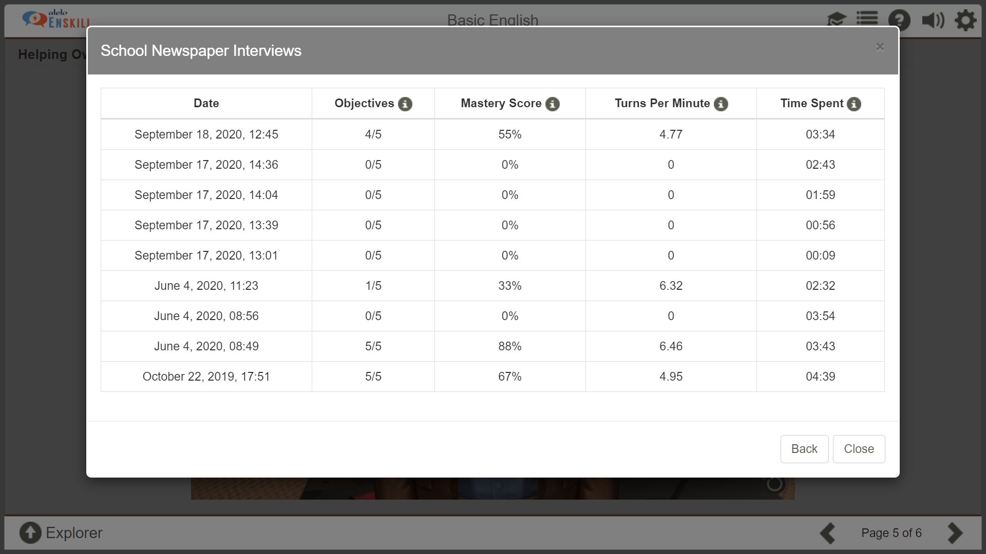
Performance on each attempt

Slide 37
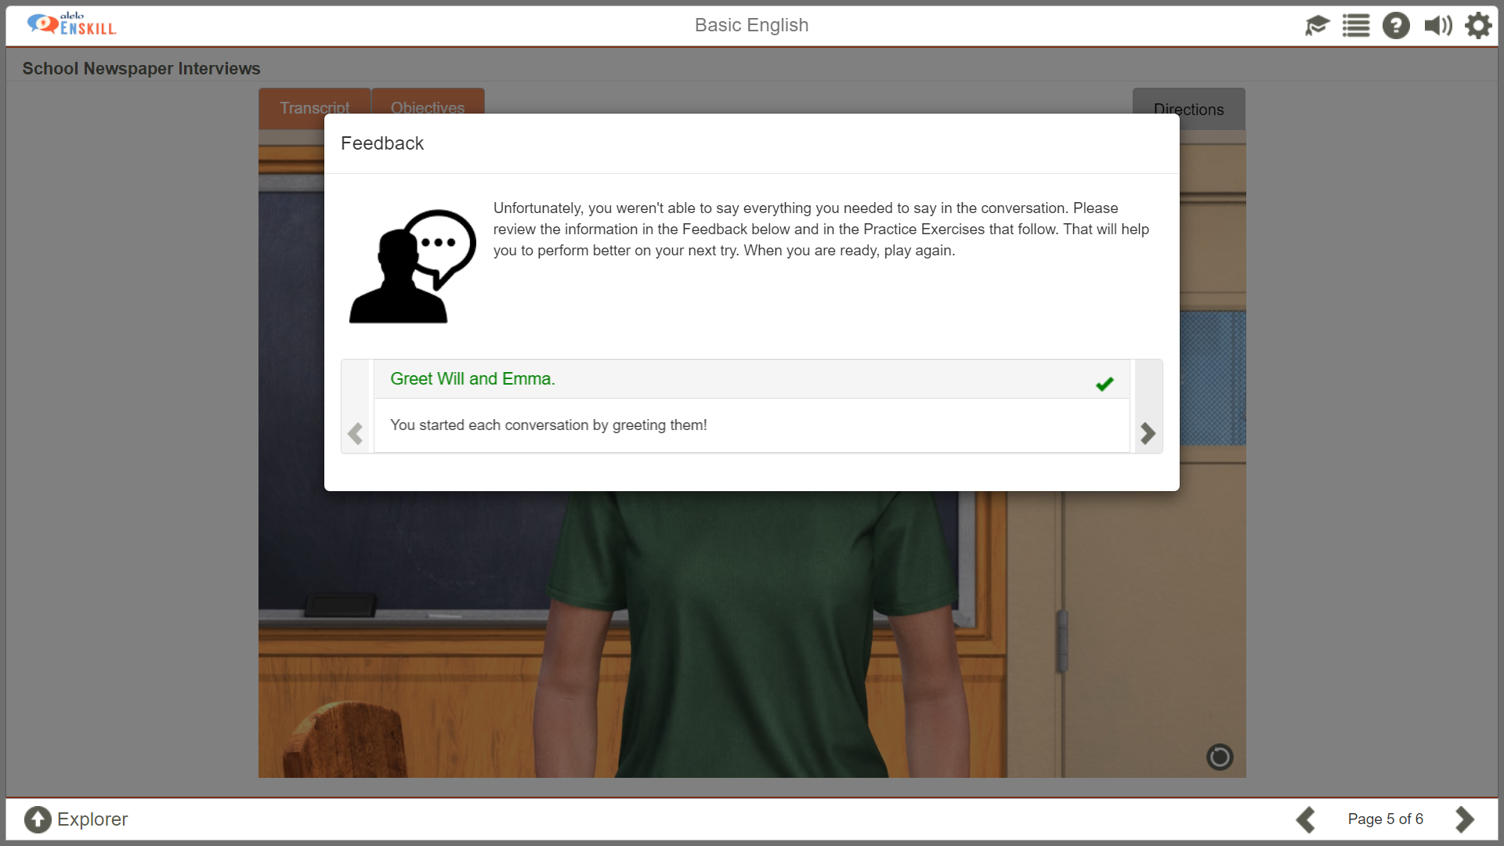
Learners receive feedback of performance after completing the simulation
Green indicates successful completion of an objective

Slide 38

RED indicates unsuccessful completion of an objective

Slide 39
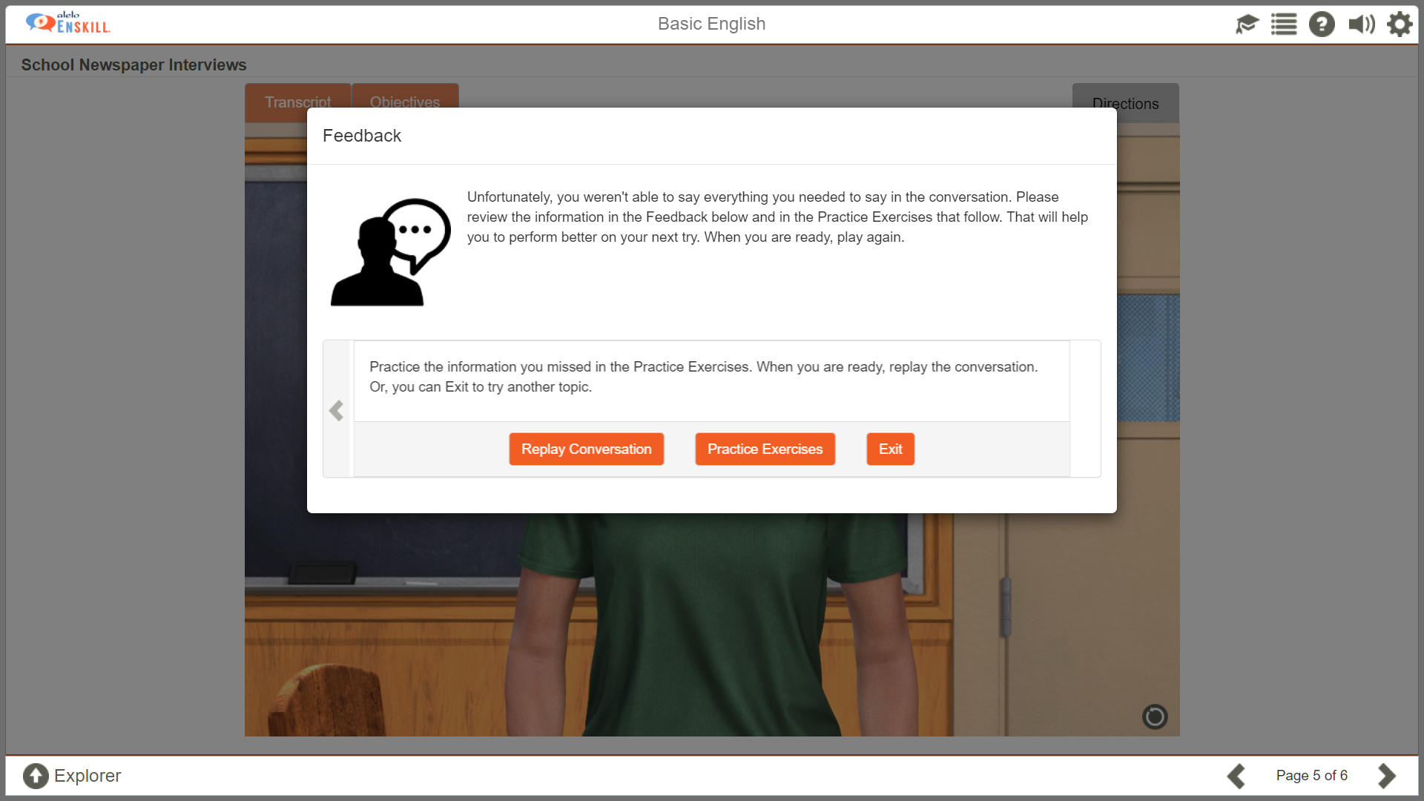
Learners have a choice of whether to try the simulation again or go to the practice exercises

Slide 40
Practice Exercises

Slide 41
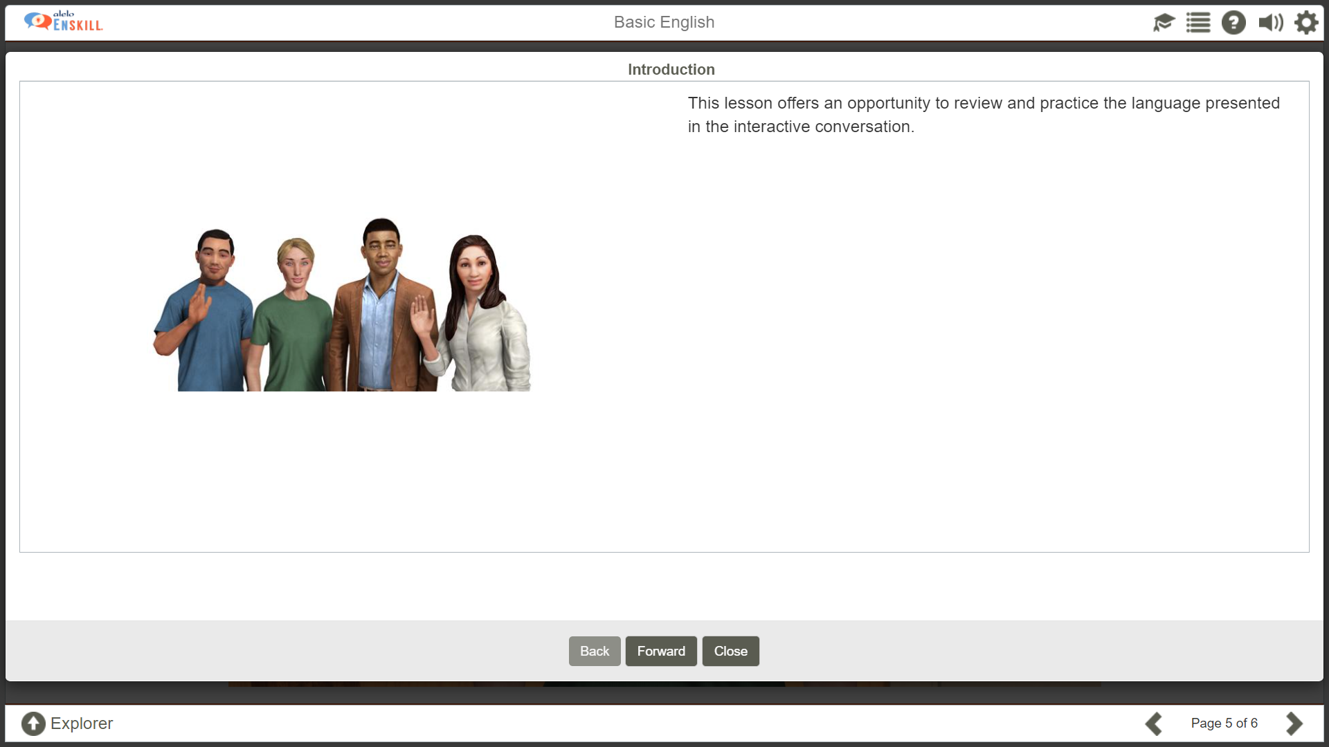
Learners are given practice in objectives and language that require improvement based on performance in the simulation

Slide 42
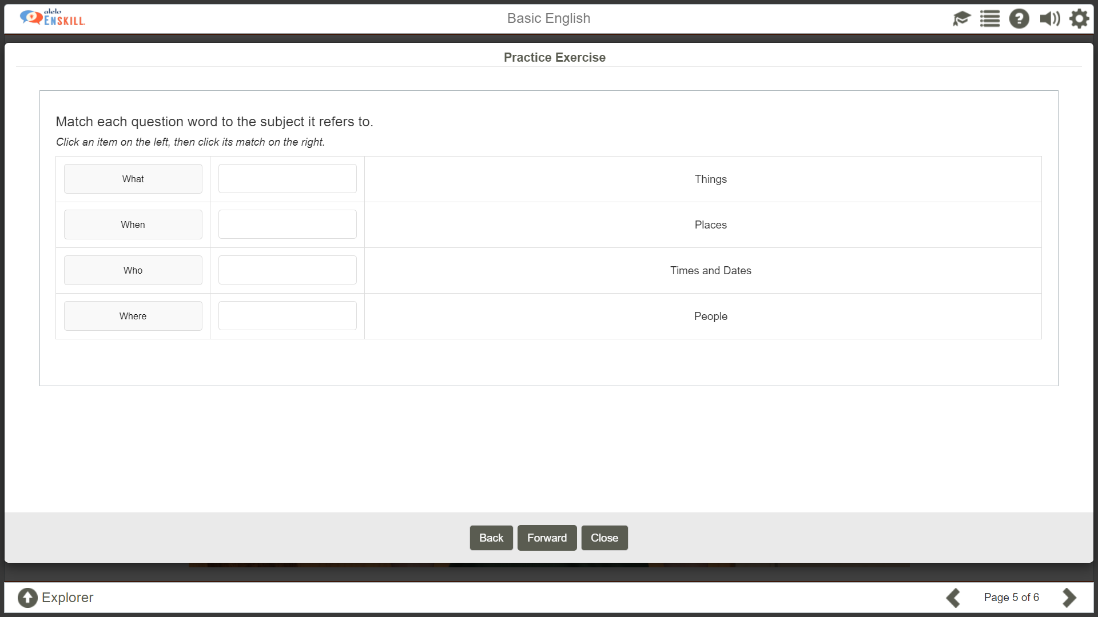
Learners practice speaking, listening and reading skills

Slide 43
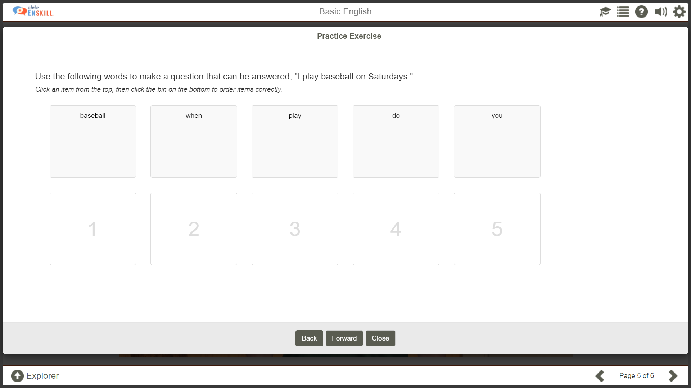
Another example of an exercise type

Slide 44
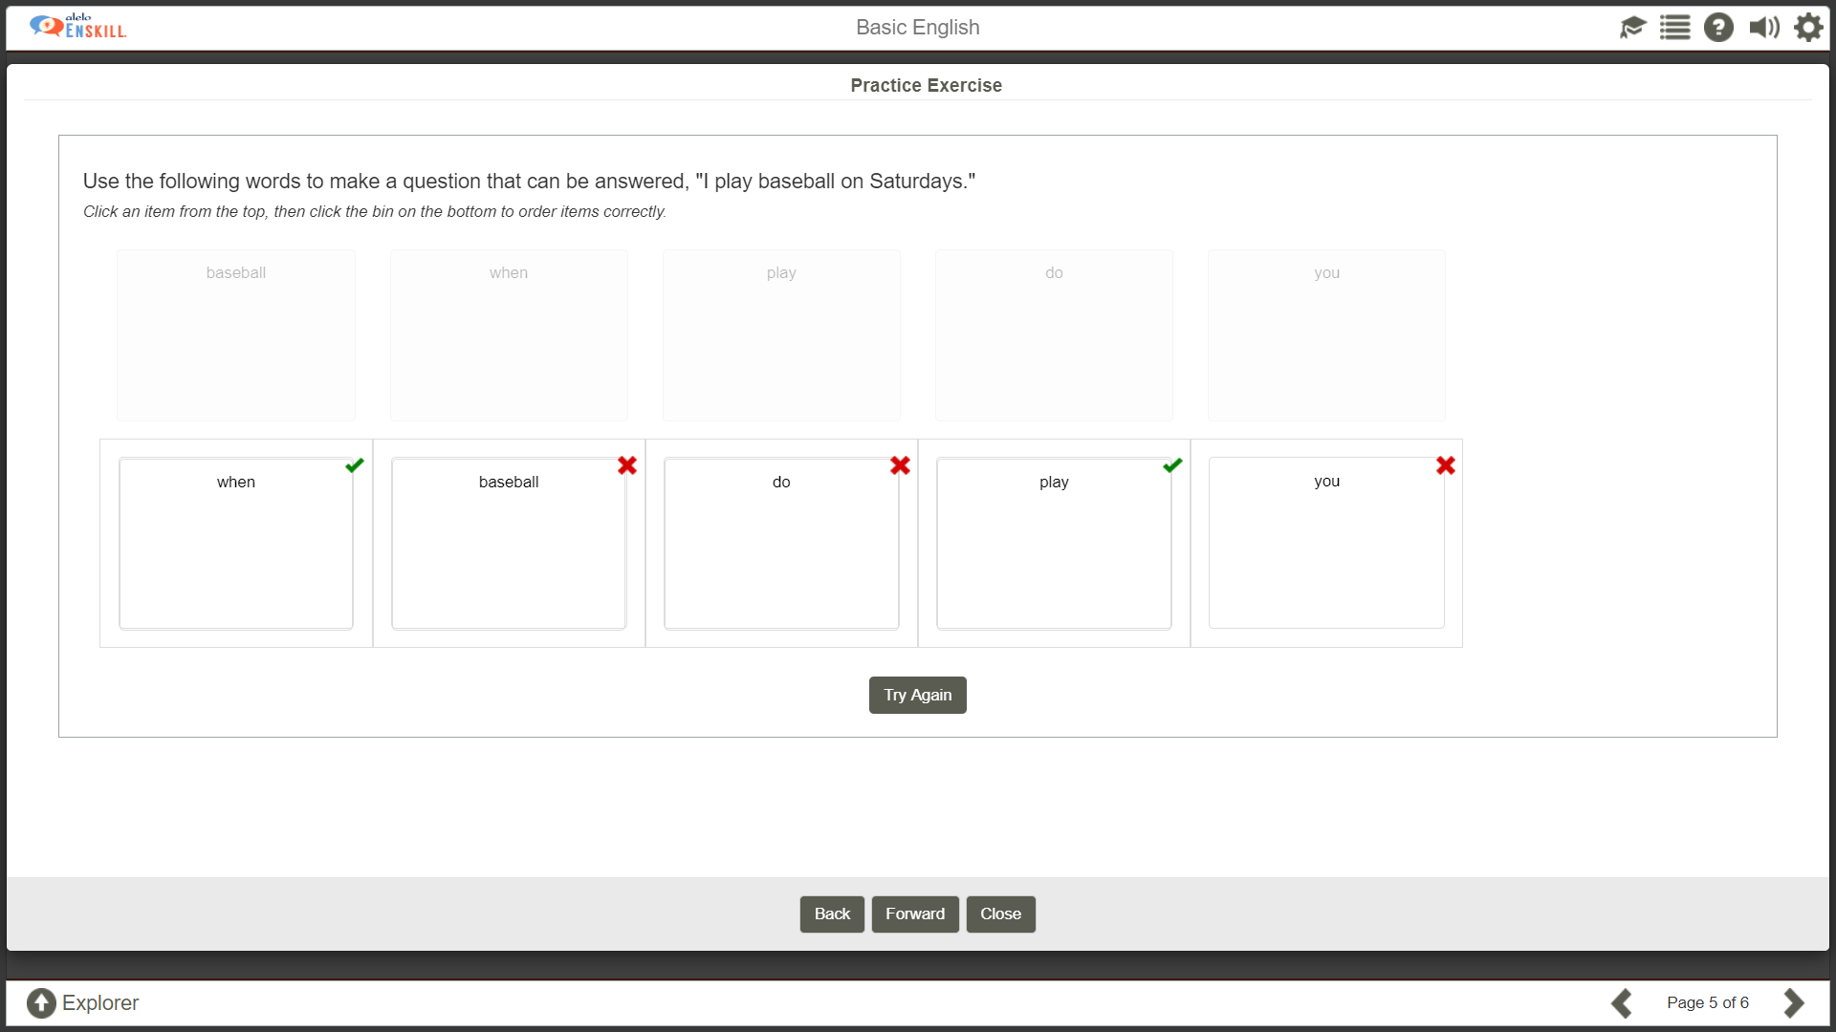
Learners receive automatic feedback on whether an exercise is correctly completed

Slide 45
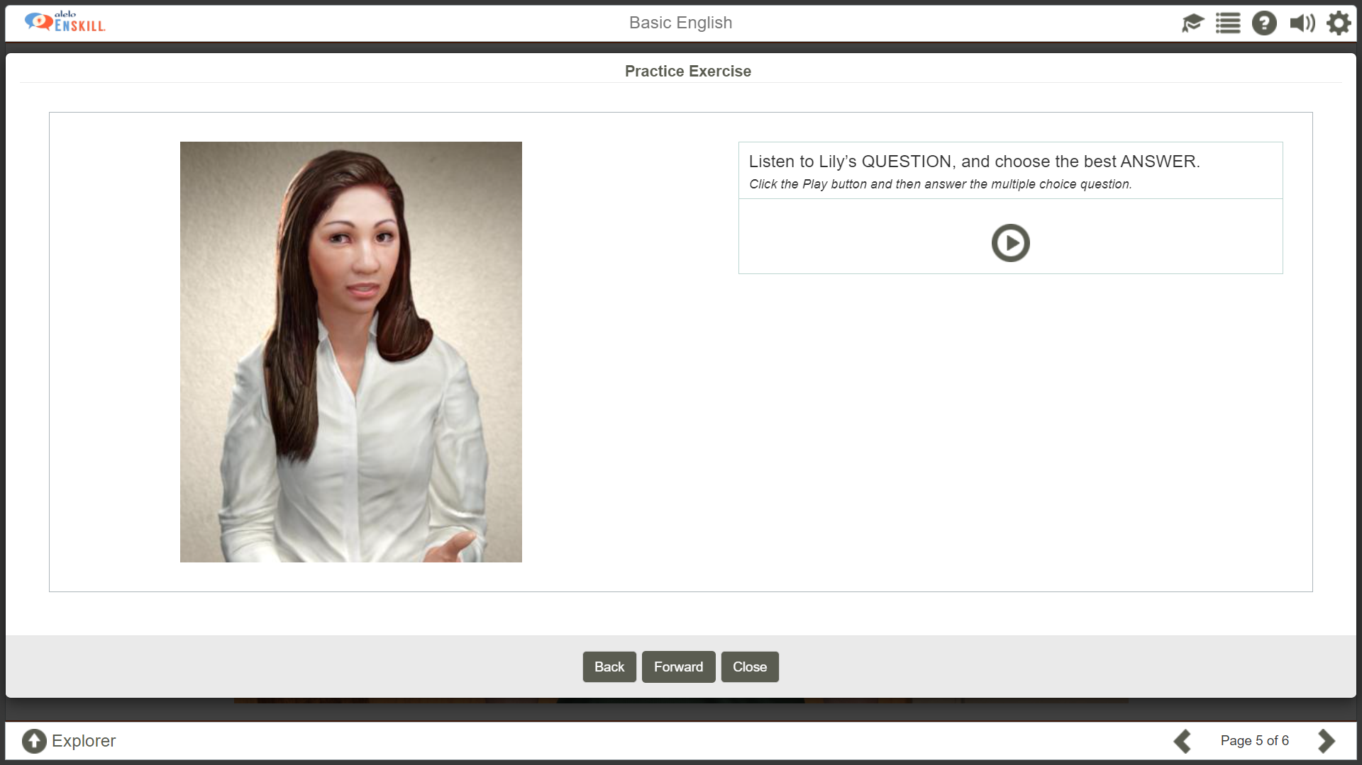
Some exercises require learners to listen and respond

Slide 46
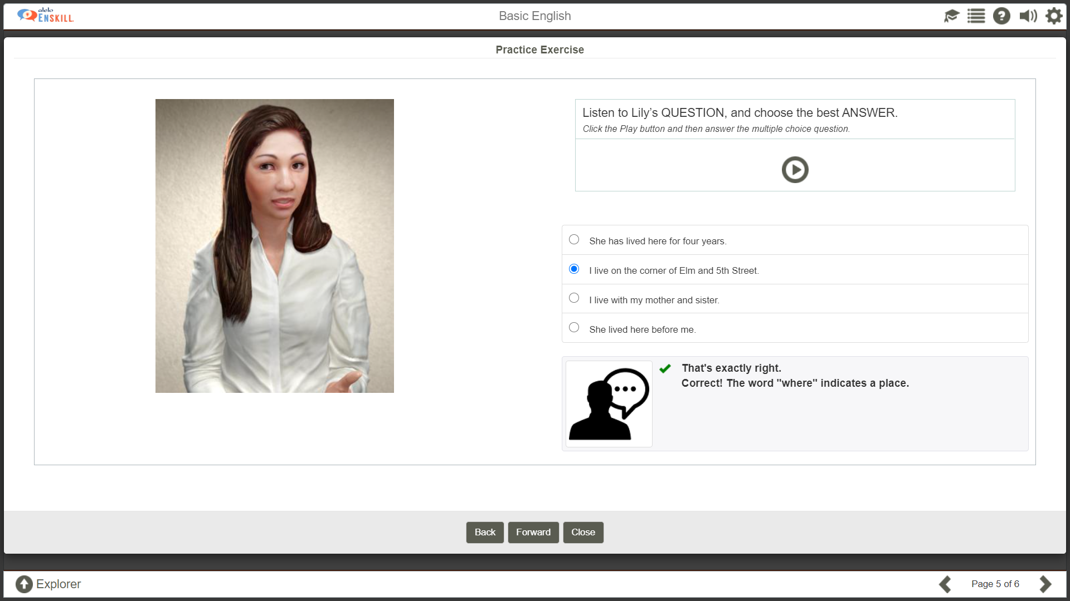
Learning reminders are provided

Slide 47
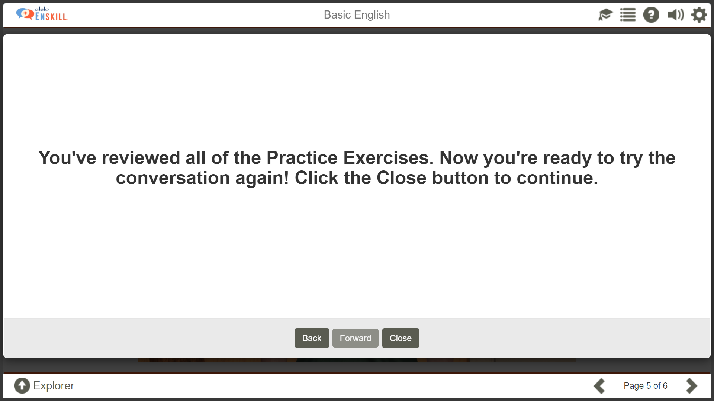
As students become more comfortable with a simulation, they should be encouraged to try new language
Learners can try the simulation again. Number of tries is not limited and the use of different language is not restricted

Slide 48
Simulations in the classroom

Slide 49
Simulations aligned with CEFR Can Do Statements
Helping Owen Plan a Party | Students can: indicate time by such phrases as ”next week”, ”last Friday”, ”in November”, ”three o’ clock ask people questions about where they live, people they know, things they have, etc. and answer questions ask simply for directions understand simple directions can use and understand simple numbers in everyday conversations describe what I like and what I don’t like | "On Sunday. I want everyone to arrive at 6:30 PM." "Do you have music? “Where is the party?” "It's on the corner of Elm and 13th Street." “We can take a bus.” “It costs $10.” “I like pizza.”
School Newspaper Interviews | Students can: use basic greeting and leave taking expressions ask and answer (simple personal) questions, like "What’s your name?", "How old are you?". ask and answer simple questions and respond to simple statements on familiar topics indicate time by such phrases as ”next week”, ”last Friday”, ”in November”, ”three o’ clock” | "Hello, how are you?" “My name is Will.” What kind of sports do you play? On Saturday
Class Interview with Lily | Students can: ask how people are. On the phone provide basic, prepared information, e.g. my name, address, telephone number, my request. give personal information (address, telephone number, nationality, age, family, and hobbies) | “I am fine. How are you?” “This is Lillie.” “I am a student and a waitress.”
Example from Simulation
CEFR Can DO Statements

Slide 50
Simulation can work with all types of classrooms
Blended
  Extension of classwork
  Assigned for language lab and homework
On-line
  Part of overall on-line curriculum
  Extension of on-line curriculum

Slide 51
Face to Face/Blended
Pre-
Utilize class time to introduce CEFR Objectives
Elicit key vocabulary and structures
Extend discussion on “context”
Encourage students to preview simulations
Post-
Comprehension questions and dialogue
Elicit key vocabulary and structures from simulation
Roleplay simulation with one student playing avatar
Elicit “what next”
Learners practice simulations more if needed and desired

Slide 52
On-line
Pre-
Learners brainstorm potential vocabulary and structures around topic
  Share with instructor
  Share with other on-line students
Teacher elicits/provides examples of key vocabulary and structures
Teacher posts CEFR objectives
Post-
Instructor posts comprehension questions
Students practice simulation in chat room with one student playing role of avatar

Slide 53
Keep in mind
Enskill does:
  Let students practice spoken English interaction skills
  Engage in task-based conversations relevant to real-life situations
  Understand learner speech, in spite of errors in pronunciation/grammar/usage
  Select exercises based on learners skill gaps in conversation
Enskill does not:
  Engage in unconstrained conversation. If you say things that are off topic it probably won't understand you.
  Drill grammar and pronunciation during conversations.
  Understand very complex language spoken by native speakers. It's designed for language learners.

Slide 54
Completion

Slide 55
